Slide 1
The Science of Reading
What is it, how is it being implemented in Wisconsin, and what does it mean for libraries?
Merrill, WI - October 2, 2024
Mary Newton
info@wi.thereadingleague.org
www.wi.thereadingleague.org

Slide 2
The Science of Reading
Topics for today:
Introduction to The Reading League Wisconsin
A Definition of The Science of Reading
The Simple View of Reading
Scarborough’s Reading Rope
Bringing the Science of Reading into Schools: WI Act 20
Bringing the Science of Reading into the Library

Slide 3
The Reading League Wisconsin
Our mission is to advance the awareness, understanding, and use of evidence aligned reading practices in schools.
Our activities:
School year virtual series
Summer book study
Annual conference
Outreach events
Dialogue with DPI and the state legislature

Slide 4
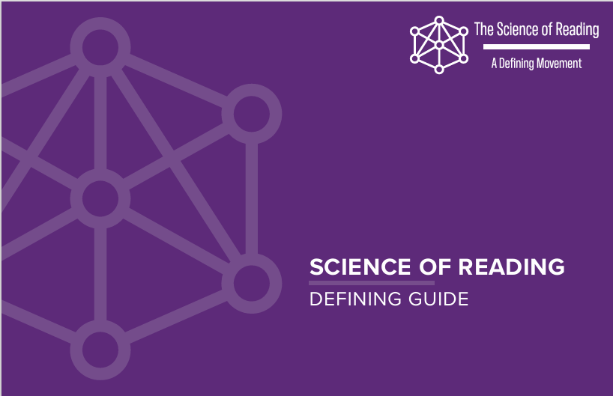
Notes:
This booklet - The Defining Guide - by our parent organization, The Reading League, is a good start at understanding what the “science of reading” is and is not..

Slide 5
The Defining Guide
The product of an 11-month collaboration of 21 stakeholders representing a wide range of literacy organizations
Available for free download at thereadingleague.org under Resources
Print copies available for $7.99

Slide 6
The Definition
The science of reading is a vast, interdisciplinary body of scientifically-based research about reading and issues related to reading and writing.
This research has been conducted over the last five decades across the world, and it is derived from thousands of studies conducted in multiple languages. The science of reading has culminated in a preponderance of evidence to inform how proficient reading and writing develop; why some have difficulty; and how we can most effectively assess and teach and, therefore, improve student outcomes through prevention of and intervention for reading difficulties.

Slide 7
Where Does the Research Come From?
→ Cognitive Psychology → Communication Sciences
→ Developmental Psychology → Education
→ Special Education → Implementation Science
→ Linguistics → Neuroscience
→ School Psychology → Speech and Language Psychology

Slide 8
The Explosion of Brain Science
Reading is not natural (unlike speech)
Multiple areas and networks in the brain are used:
Print, speech sounds, language, and meaning
We need to build the neural connections between these areas for reading
Efficient pathways develop with explicit instruction and deliberate practice

Slide 9
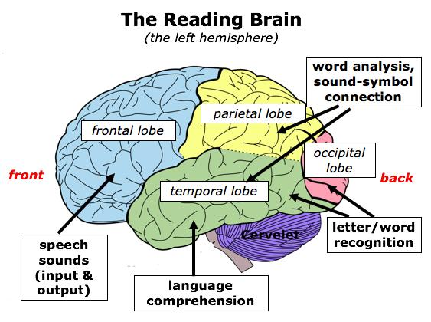
How the Brain Learns to Read
Keys to Literacy
Notes:
Frontal lobe, including Broca’s area - speech production
Parietal temporal - grapheme/phoneme connection
Temporal lobe grammatical usage, and comprehension, making it possible to understand simple and complex grammar in our native language.
Temporal Occipital = brain’s letterbox or visual word form area = reading fluency
All must be connected and working simultaneously after initial visual recognition linked to sound, then meaning
Broca’s area (frontal) for speech production connected to Wernicke’s area (temporal) for language comprehension via arcuate fasciculus
Reading is not natural!

Slide 10
To Learn More About the Brain Science
Watch the first 15 minutes of How the Brain Learns to Read from Prof. Stanislas Deheane
https://www.youtube.com/watch?v=25GI3-kiLdo
See pages 21-32 in Learning to Read: A Primer Part One from Amplify for time-lapse fMRI images of the brain while speaking a word and reading a word
https://go.info.amplify.com/primer-pt1

Slide 11
Linking Research to Practice
The goal of reading is deep comprehension of text, which requires automatic word level processing.
“Educators who are knowledgeable about the necessary connections between the pronunciation of the spoken word, the sequence of letters in the written word, and the meaning of the word, can implement reading instruction and assessment that promotes the level of automatic word recognition that is necessary for the deep processing of the meaning of texts.”
Notes:
To understand how a student develops into a skillful reader (a fluent and accurate reader who can comprehend text), we look at two useful frameworks of reading: The Simple View and Scarborough’s Reading Rope.

Slide 12
The Simple View of Reading
D x LC = RC
Decoding
(word recognition)
Language
comprehension
Reading
comprehension
(Gough & Tunmer, 1986)
Notes:
Over 150 studies have validated the Simple View. It shows us that proficient reading is the product - not the sum - of word recognition and language comprehension. Strength in one area cannot compensate for weakness in the other. If either domain is weakened, reading comprehension is diminished. The Simple View is, in fact, not simple at all. The model is useful as an overview, but there are many details about what is entailed in word recognition and language comprehension. For that we need to for in-depth understanding. For that, we turn to Scarborough’s Reading Rope model.

Slide 13
Animate as in original slide
The Many Strands Woven Into Skilled Reading
Language Comprehension
Background Knowledge
Vocabulary Knowledge
Skilled Reading:
Fluent execution and coordination of word recognition and text comprehension
Language
comprehension
Language Structures
increasingly strategic
Verbal Reasoning
Literacy Knowledge
Word Recognition
increasingly automatic
Reading
comprehension
Phonological Awareness
Decoding
(word recognition)
Decoding
(word recognition)
Decoding (and Spelling)
Sight Recognition
(Scarborough, 2001)
Notes:
This rope model by reading researcher Hollis Scarborough is a visual metaphor for how a student develops into a skilled reader over time. It lays out the various skills in the word recognition and language comprehension domains of The SImple View and shows how they develop simultaneously and with time are integrated to support each other. When we look at each of these skill strands more closely, we can see why reading is so complicated..

Slide 14
Reading Skill Patterns
+
Good LC x Weak D
Beginning readers
People with learning difficulties such as dyslexia
Good LC x Good D
No reading difficulty
Language Comprehension
-
+
Decoding/Word Recognition
Weak LC x Weak D
Beginning readers who are learning English
Readers with difficulties in both domains
Weak LC x Good D
English learners
Readers with Developmental Language Disorder
-
Notes:
The Simple View of Reading allows us to recognize a student’s particular pattern of reading skills. Screening helps us learn where students fall on the continuum of reading skill patterns, and allows us to focus instruction and intervention accordingly to build up any weak skills.

Slide 15
What the Science of Reading Is NOT
An ideology or philosophy
A fad, trend, new idea, or pendulum swing
A political agenda
A one-size-fits-all approach
A program of instruction
A single, specific component of instruction, such as phonics

Slide 16
Word Recognition Instruction
Aligned Not Aligned
Phoneme level focus for Focus on rhyming, syllables,
alphabetics instruction and onset-rime to learn reading
Explicit and systematic Implicit and incidental instruction in decoding and encoding word reading; visual memorization
instruction following a scope of whole words; guessing from
and sequence context, picture, or syntax cues
Text reading to build Emphasis on speed over accuracy in
accuracy, automaticity, text reading
fluency, and comprehension
Practice includes decodable Practice focuses on leveled or
text at the early levels patterned text or sustained silent
reading for all students

Slide 17
Language Comprehension Instruction
Aligned Not Aligned
Read-alouds from a variety Read-alouds from non-complex
of complex texts to build leveled text that students will be
knowledge and vocabulary reading later
Robust conversation to A lack of explicit instruction of
develop morphology and of morphology; memorization of
academic language, isolated word definitions out-of-
including narrative and context; lack of strategic and
inferential language intentional instruction
Explicit instruction in Implicit instruction of grammatical
grammatical structures structures
and academic vocabulary
during other reading activities

Slide 18
Bringing the Science Into WI Schools:
Under Act 20 (2023), Wisconsin schools are required to provide science-based, explicit and systematic early literacy instruction in:
→ Phonological and Phonemic Awareness → Phonics
→ Reading fluency → Comprehension
→ Oral language development → Vocabulary
→ Writing

Slide 19
Bringing the Science Into WI Schools:
Under Act 20 (2023), Wisconsin schools may NOT provide word recognition materials or instruction that use the three-cueing model, defined as:
“...any model, including the model referred to as meaning, structure, and visual cues, or MSV, of teaching a pupil to read based on meaning, structure and syntax, and visual cues or memory.”
Notes:
Note that this is a big change for many Wisconsin schools, especially if they were using balanced literacy programs such as Lucy Calkins Units of Study, Reader’s Workshop, Fountas & Pinnell, Leveled Literacy Intervention, or Reading Recovery.

Slide 20
Other Act 20 Provisions
Teacher prep programs must align with the science
Barb Novak is the Director of the new Office of Literacy in DPI -responsible for Act 20 implementation
Literacy coaches will be trained and funded for some of the lowest performing schools
Universal screening K-3 will be conducted 3X/year
Students in the lowest 25% will receive further diagnostic assessment and personal reading plans
Districts may qualify for a partial subsidy to purchase a K-3 classroom program recommended by the Early Literacy Curriculum Council
Notes:
Screening 2x/year for 4K

Slide 21
The Four Recommended Programs
CKLA by Amplify
EL by Open Up Resources
Wit and Wisdom with Geodes and Really Great Reading
Bookworms by Open Up Resources
Notes:
Superkids is also good.
Into Reading, My View, Collaborative Classroom, and others are so-so
Not good:
Fountas and Pinnell, Lucy Calkins Units of Study (Readers and Writers Workshop), other blanched literacy programs
Interventions such as Reading Recovery and Leveled Literacy Intervention (LLI)

Slide 22
What Does This Mean for WI Libraries?
Parents and students will continue to need access to your quality children’s literature and informational text in order to build their background knowledge, vocabulary, and language comprehension skills
Parents, students, and teachers may come to you looking for different resources to help with word recognition skills: decodable books vs. leveled or patterned books that have been heavily used in schools that adopted ”balanced literacy”
Notes:
If your district has been using Fountas and Pinnell, Leveled Literacy Intervention, Lucy Calkins Units of Study, Reading Recovery, or other balanced literacy programs, you are likely to see a shift.

Slide 23
Patterned Texts
Patterned readers have repetitive text (often with pictures) intended to help the student predict the words
I see a robin. I see a crow. I see an eagle. I see a flamingo.
Patterned texts familiarize students with patterns in language, but do not teach decoding skills
Early reliance on guessing based on patterns can create non-productive habits while not providing necessary decoding practice
Great for read alouds

Slide 24
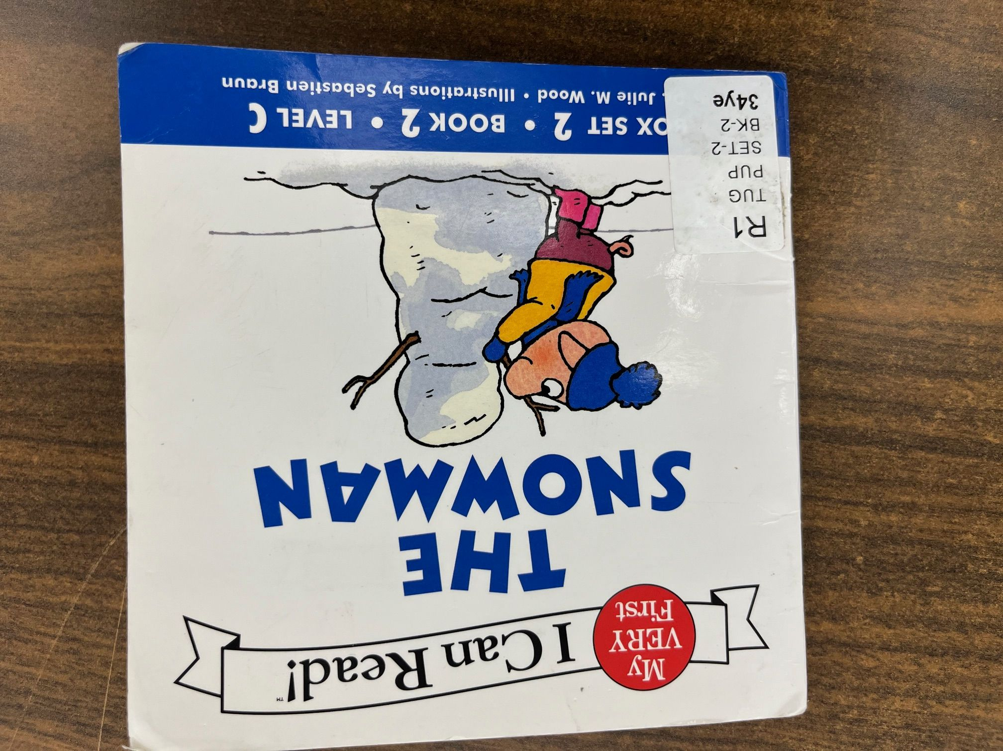

Slide 25
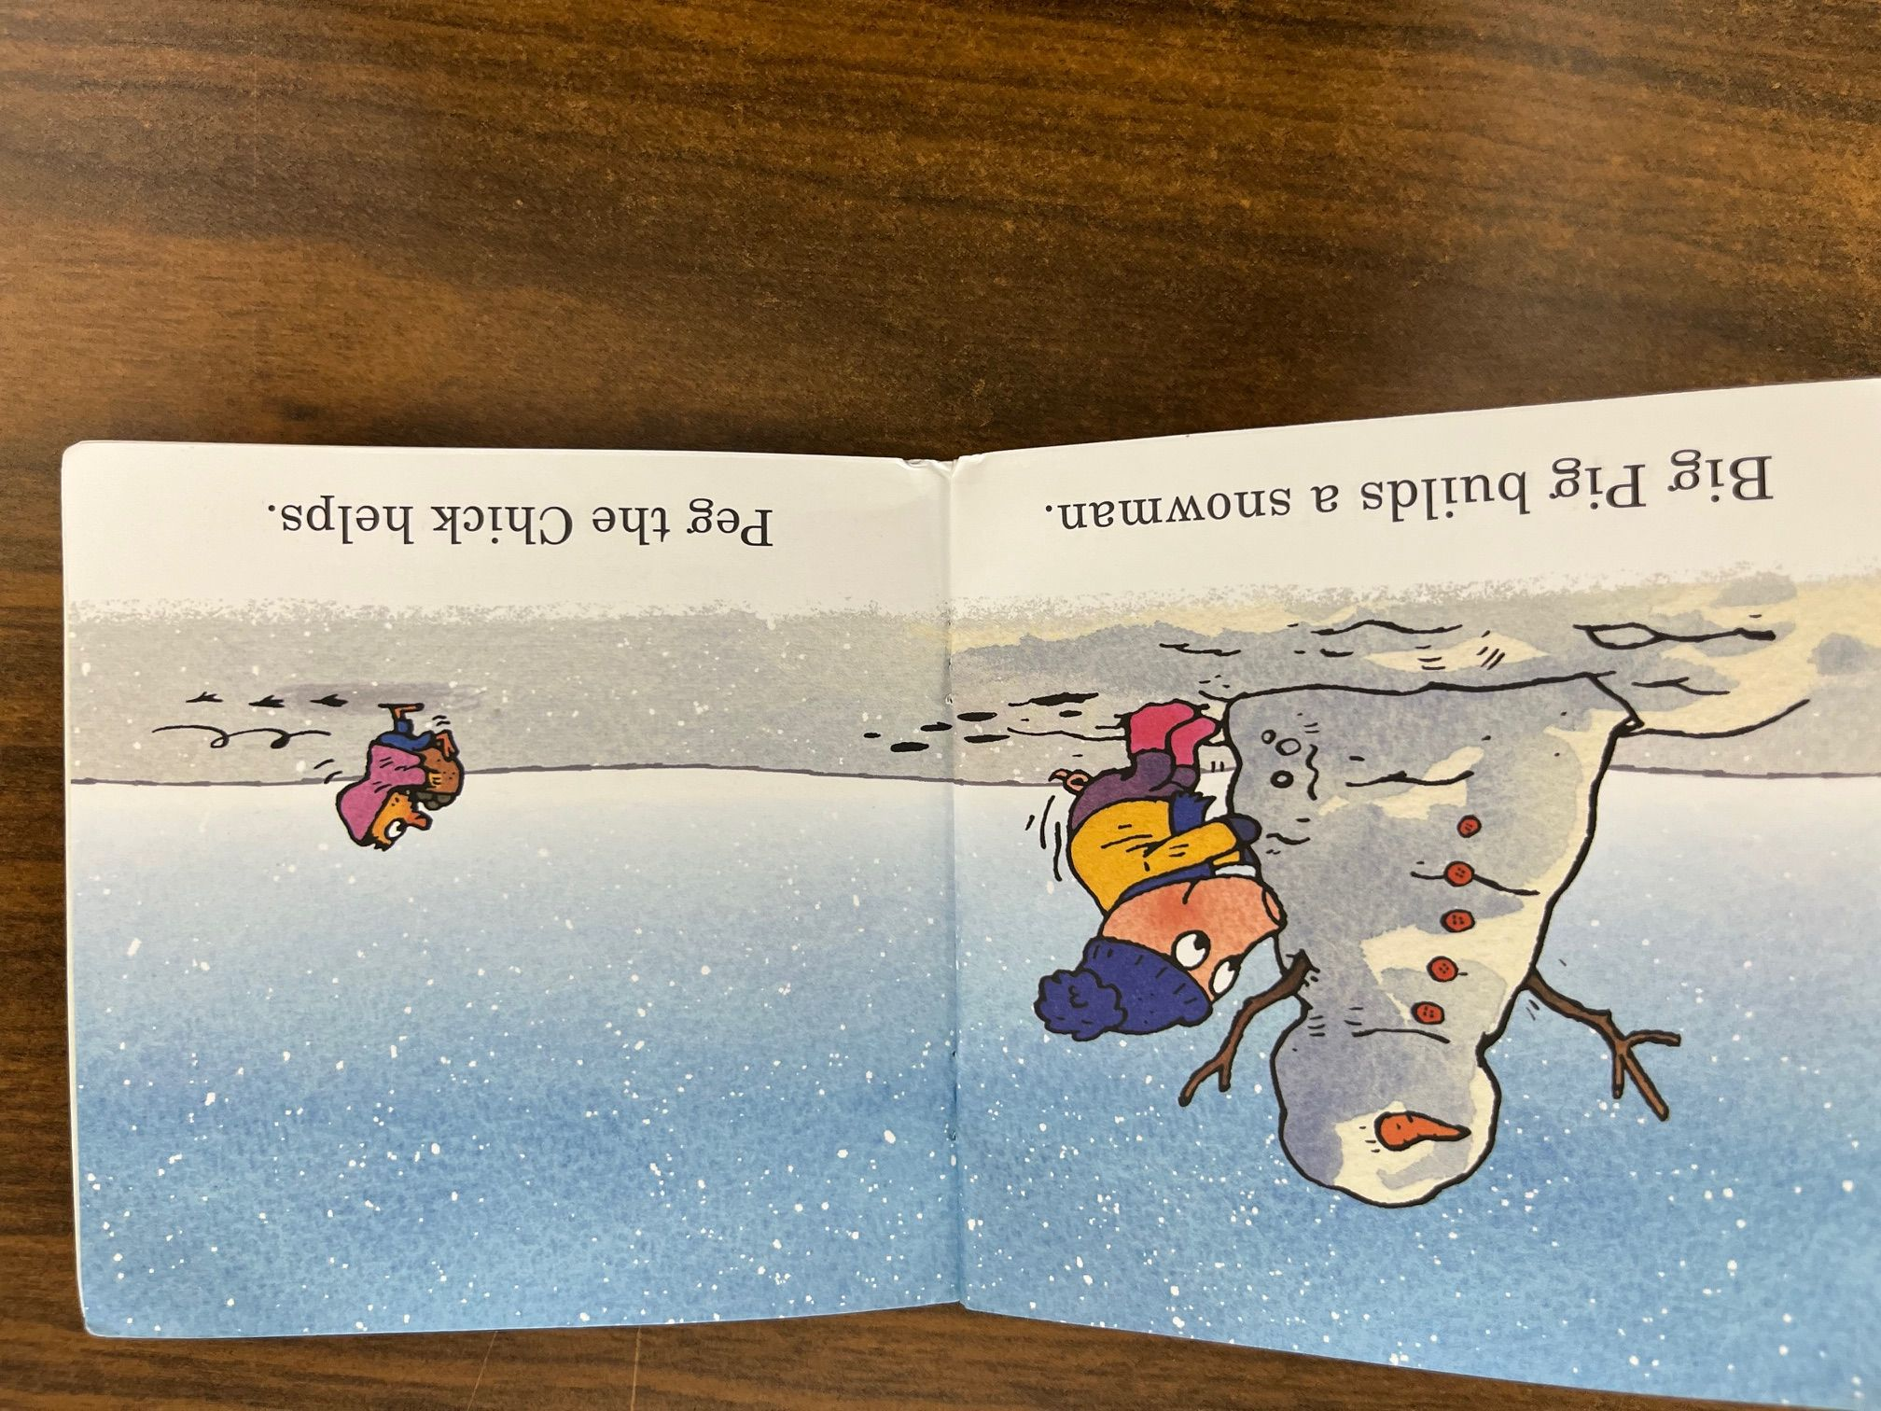

Slide 26
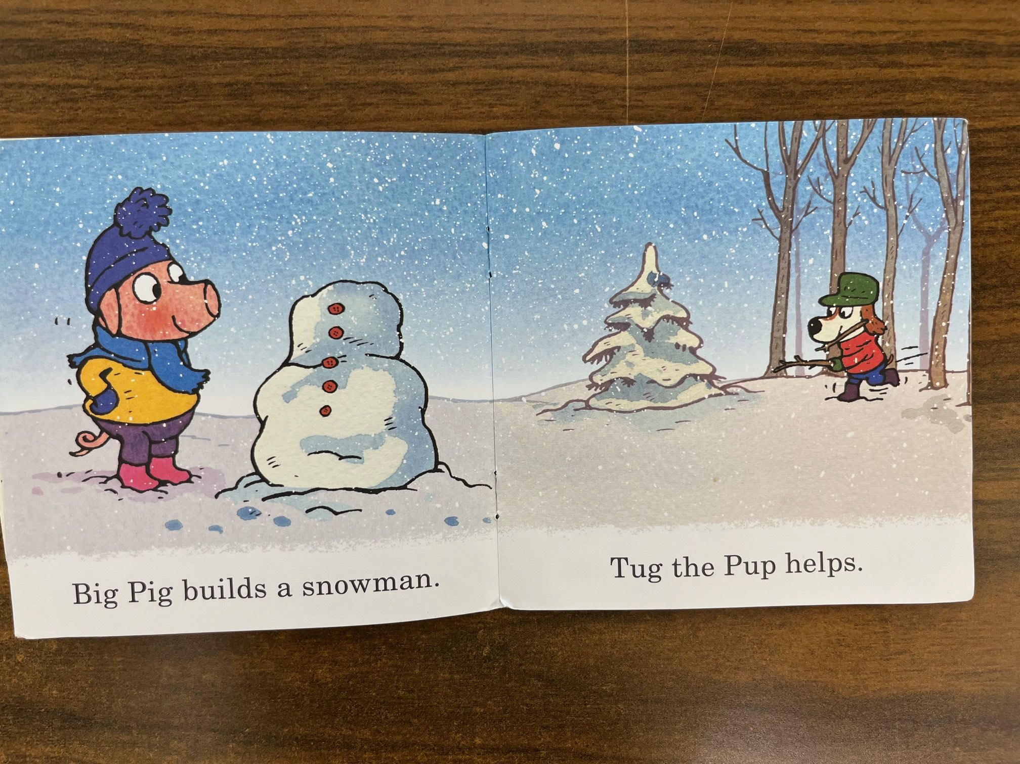

Slide 27
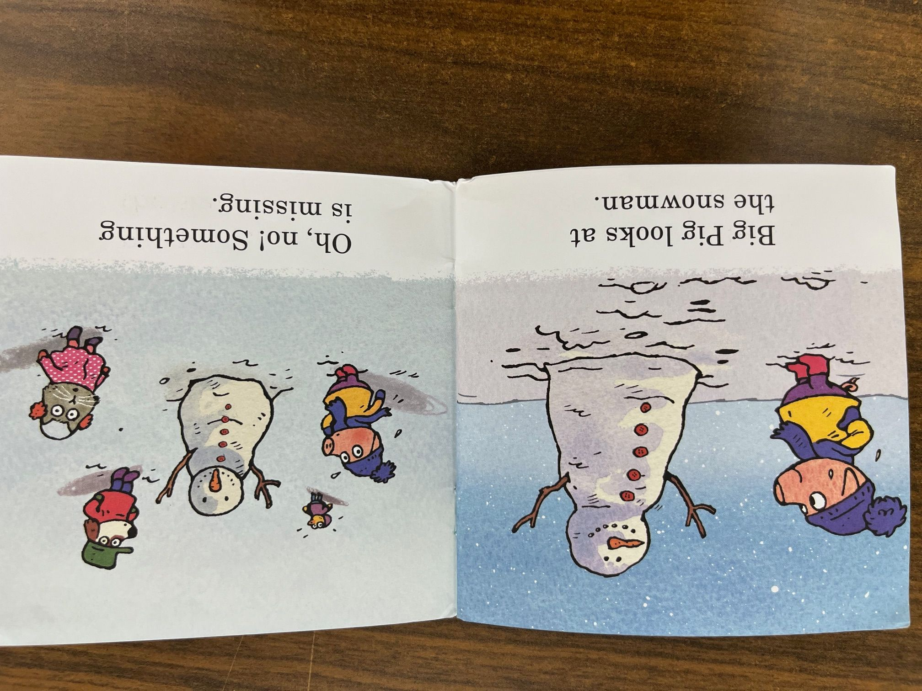

Slide 28
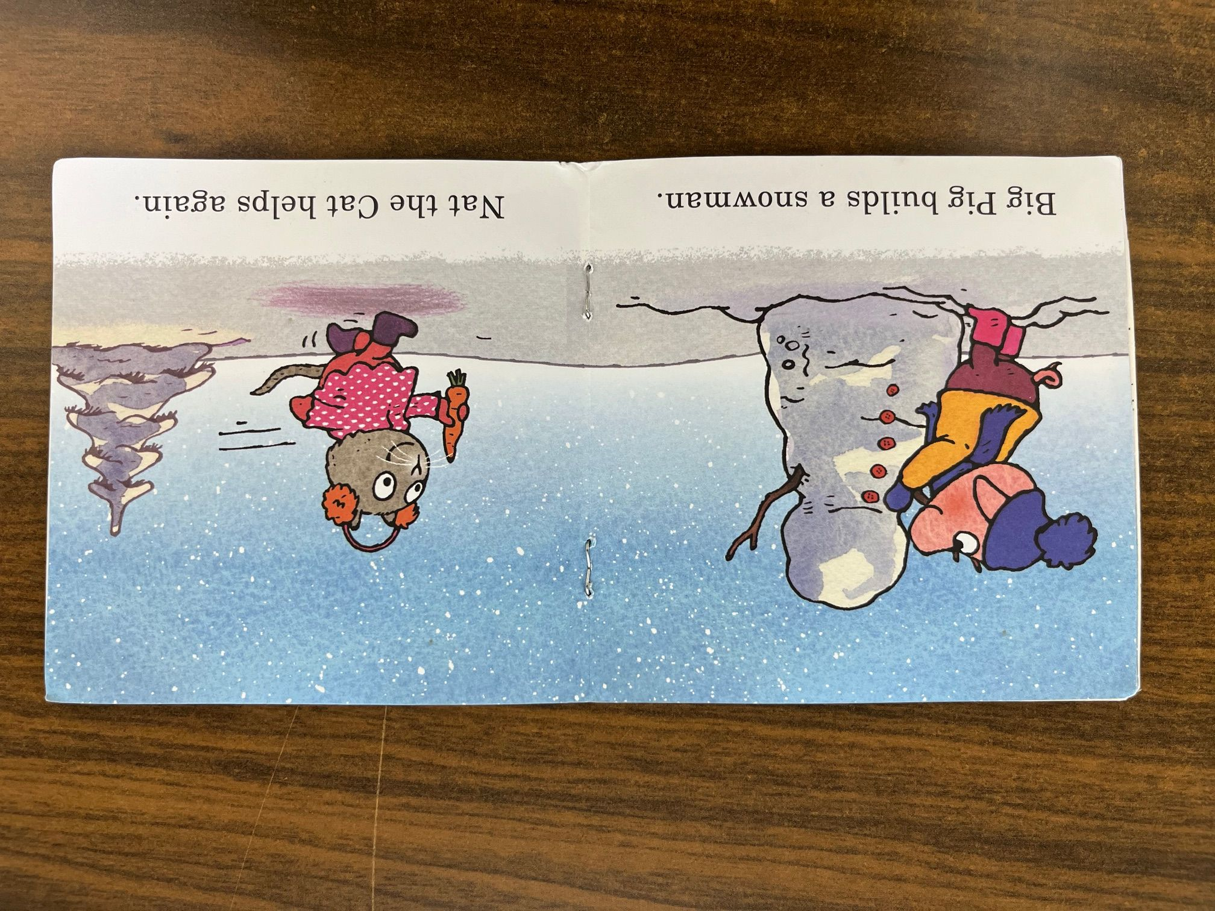

Slide 29
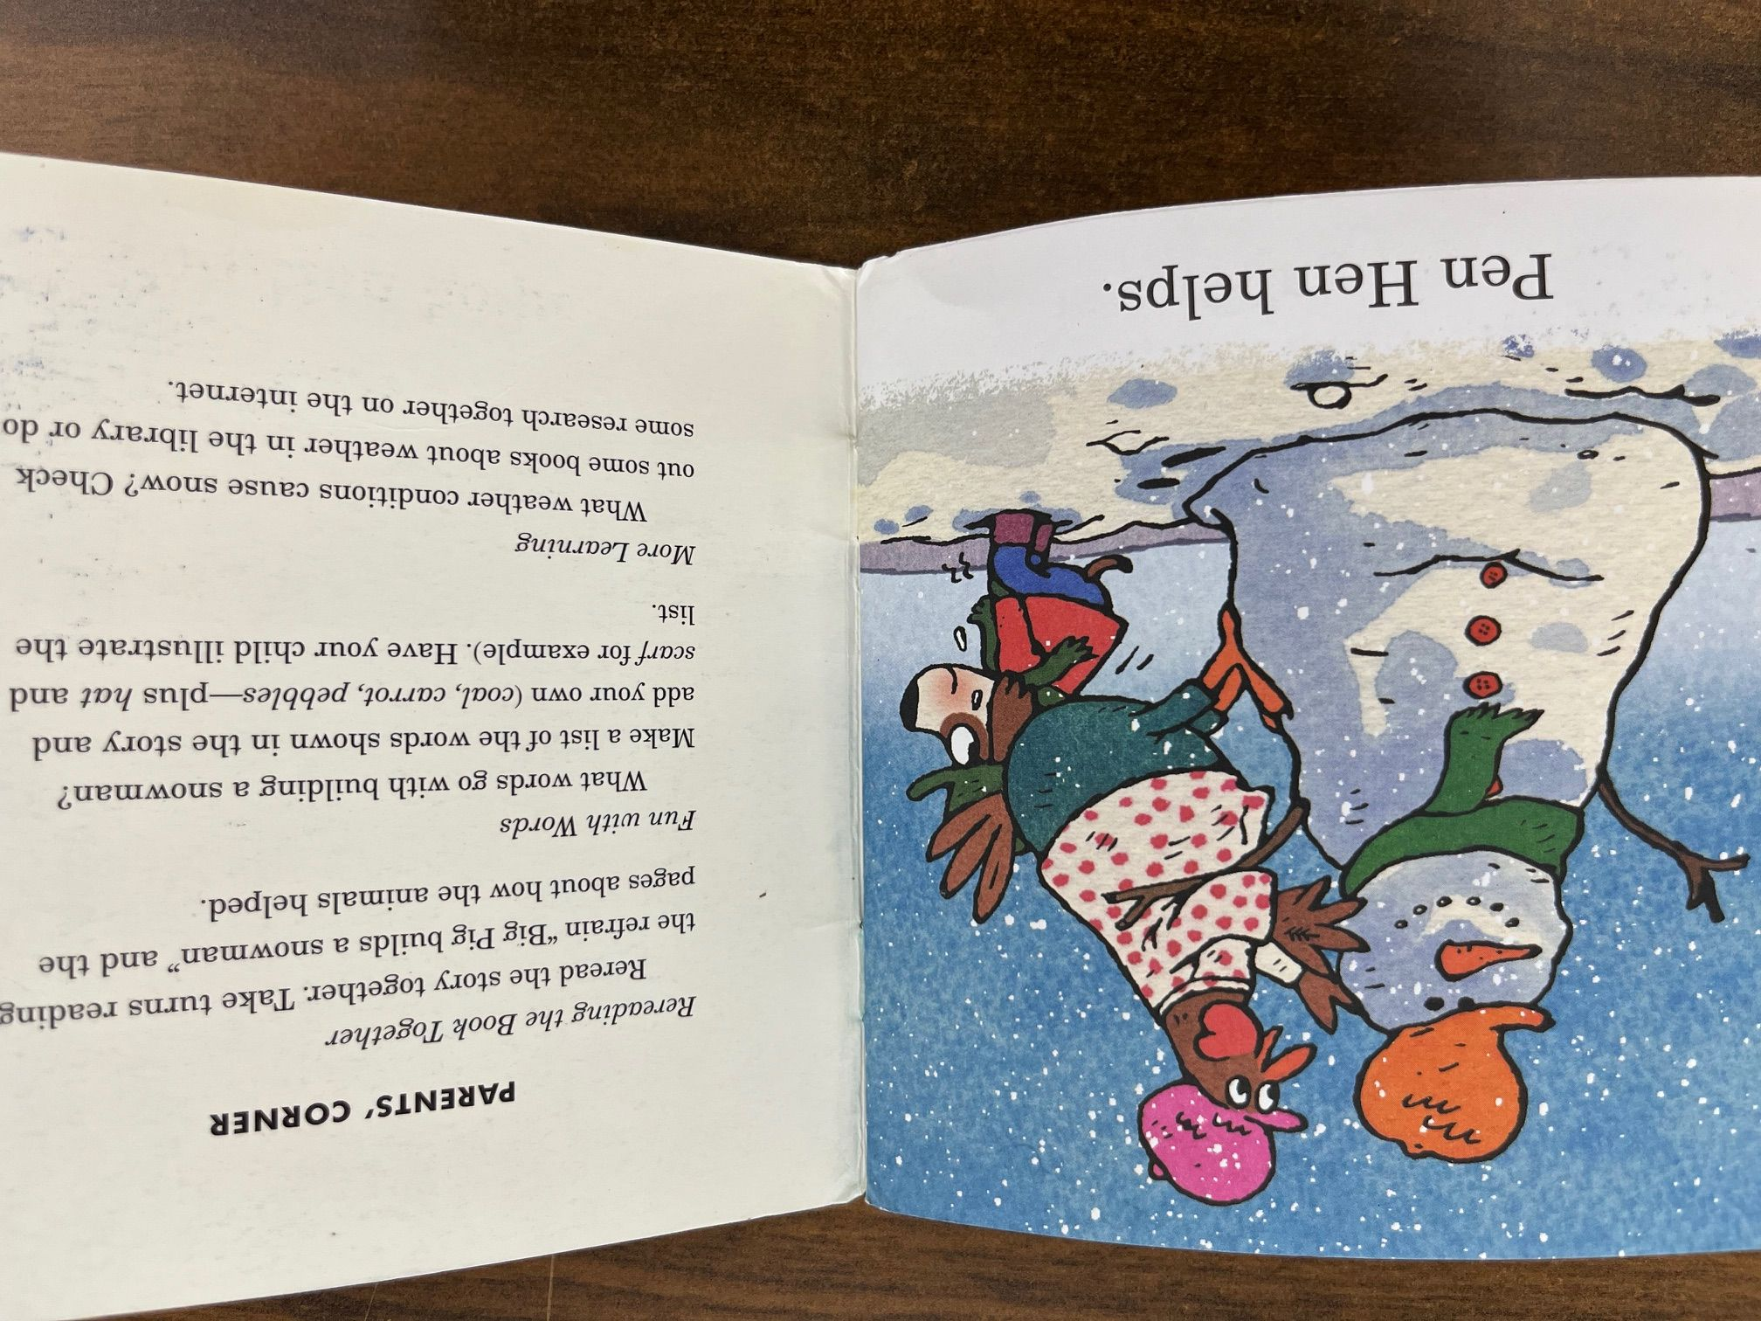

Slide 30
Leveled Texts
Leveled readers are leveled in many different ways: length of sentence, number of pictures, vocabulary, word count, etc.
Levels generally run A - Z or 1 - 70
Though intended to align with a student’s reading “level,” they are not very accurate in the early years, and they are not leveled by a sequence of phonetic decoding patterns.

Slide 31
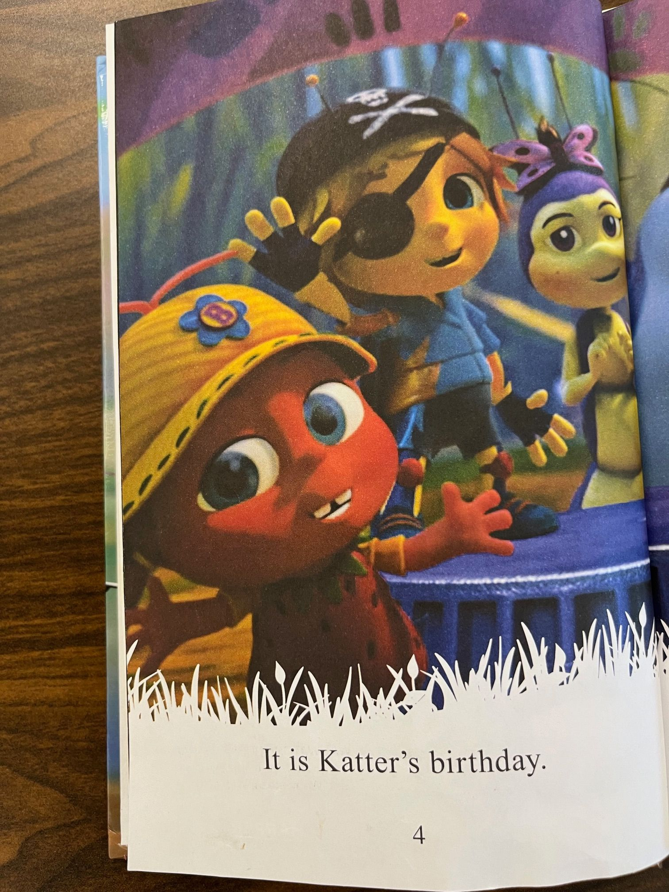

Slide 32
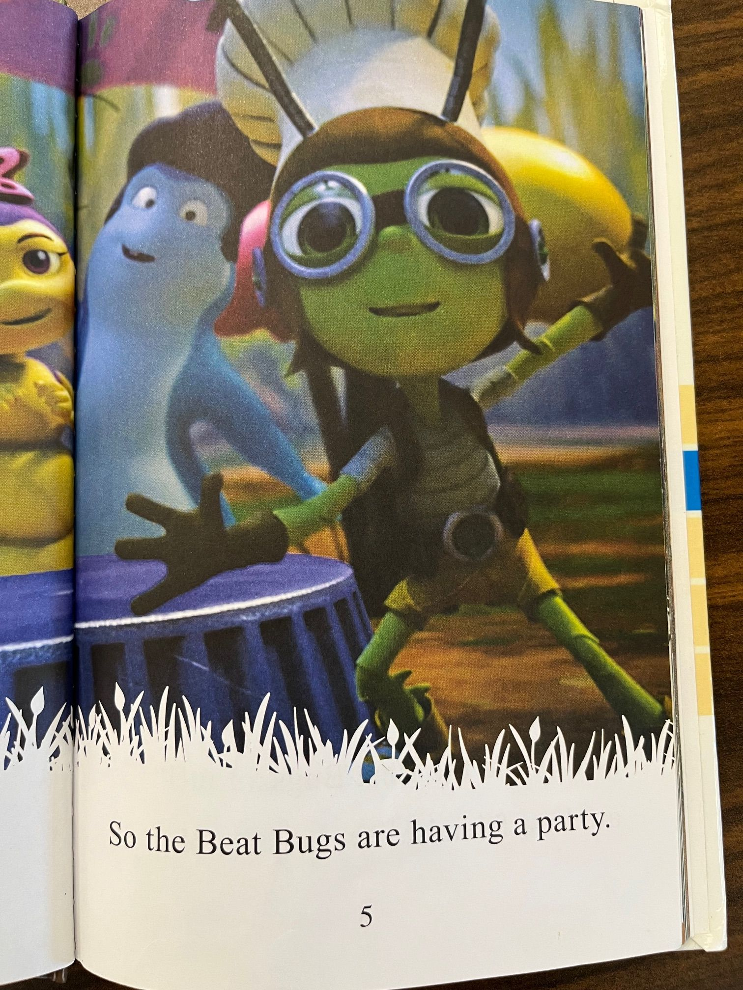

Slide 33
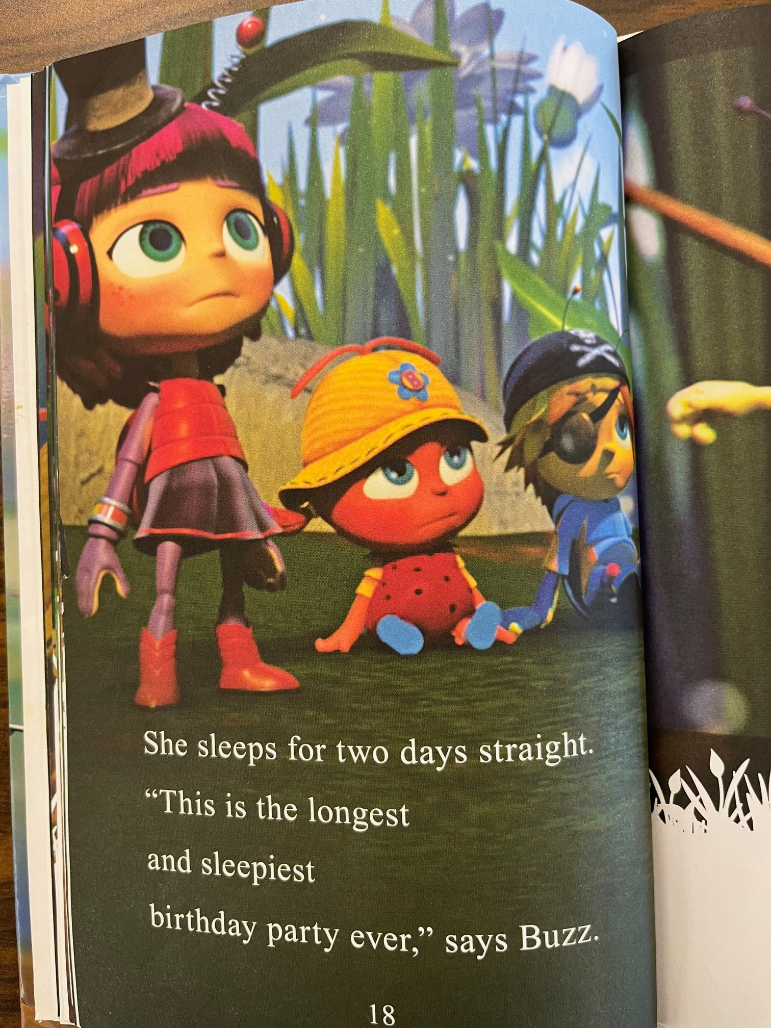

Slide 34
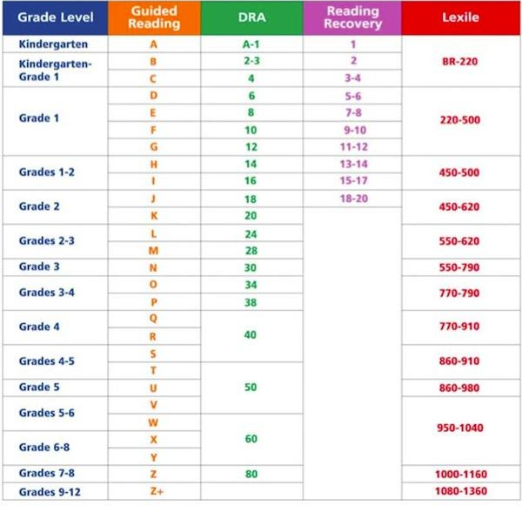

Slide 35
Decodable Texts
Follow a phonetic scope and sequence
The decodability depends on what the reader knows
VC ( it, mat), CCVC (stop), CVCC (jump), -V (be, I), VCe (ate, bake), Vr (her), Vteam (aid, night), Cle (bubble)
They provide practice with the phonetic concepts
Pictures do not aid in figuring out the words
Used primarily in early reading instruction (K-2), for introduction of new concepts in later instruction, and for intervention with struggling students or English learners
Materials beyond the decoding ability of the reader are used during read alouds

Slide 36
Teach My Kid to Read
The Road to Decode is a TMKTR initiative for libraries launched in 2019 to enlist librarians to learn about, stock, and provide parents, caregivers, and educators with information and resources that help all children, especially early and struggling readers, learn to read.
TMKTR was the first organization to promote sound aloud or decodable books, the lesser-known resources that help all children become skilled readers. Working with the public libraries, The Road to Decode enables all children to have equal access to resources that help them learn to read.

Slide 37
Resources to Help Libraries Understand and Build Decodable Collections
Join The Road to Decode Community
https://teachmykidtoread.org/register-for-the-road-to-decode-community/
Teach My Kids to Read
The Reading League Decodable Text Sources
https://www.thereadingleague.org/decodable-text-sources/
The Reading League
What Are Decodable Books and Why Are They Important?
https://www.readingrockets.org/topics/curriculum-and-instruction/articles/what-are-decodable-books-and-why-are-they-important
Reading Rockets

Slide 38
Advice from Wauwatosa Public Library
Keep the higher content decodables (Moon Dog, Saddleback) with the series books, not the early readers
Attach “Little Learners” cards to the backs of the books
Utilize a binder for an easy explanation of how Science of Reading works with patrons - also used by reading specialists for locating specific titles to meet their student's needs

Slide 39
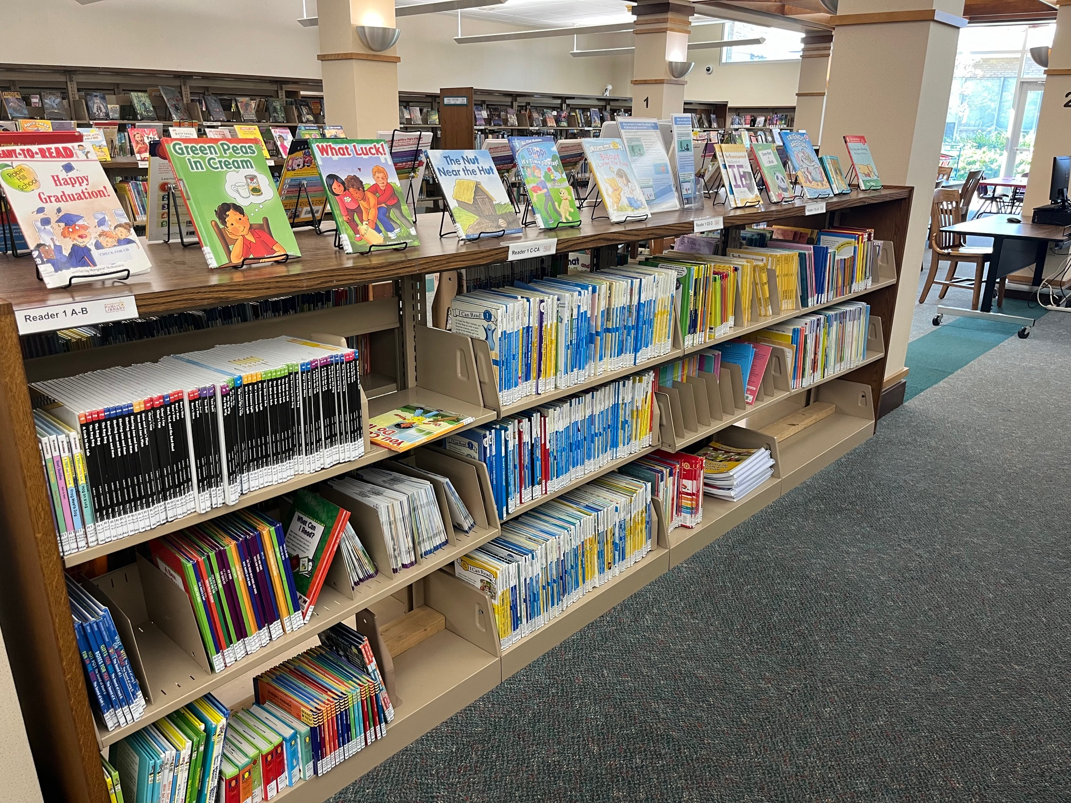

Slide 40
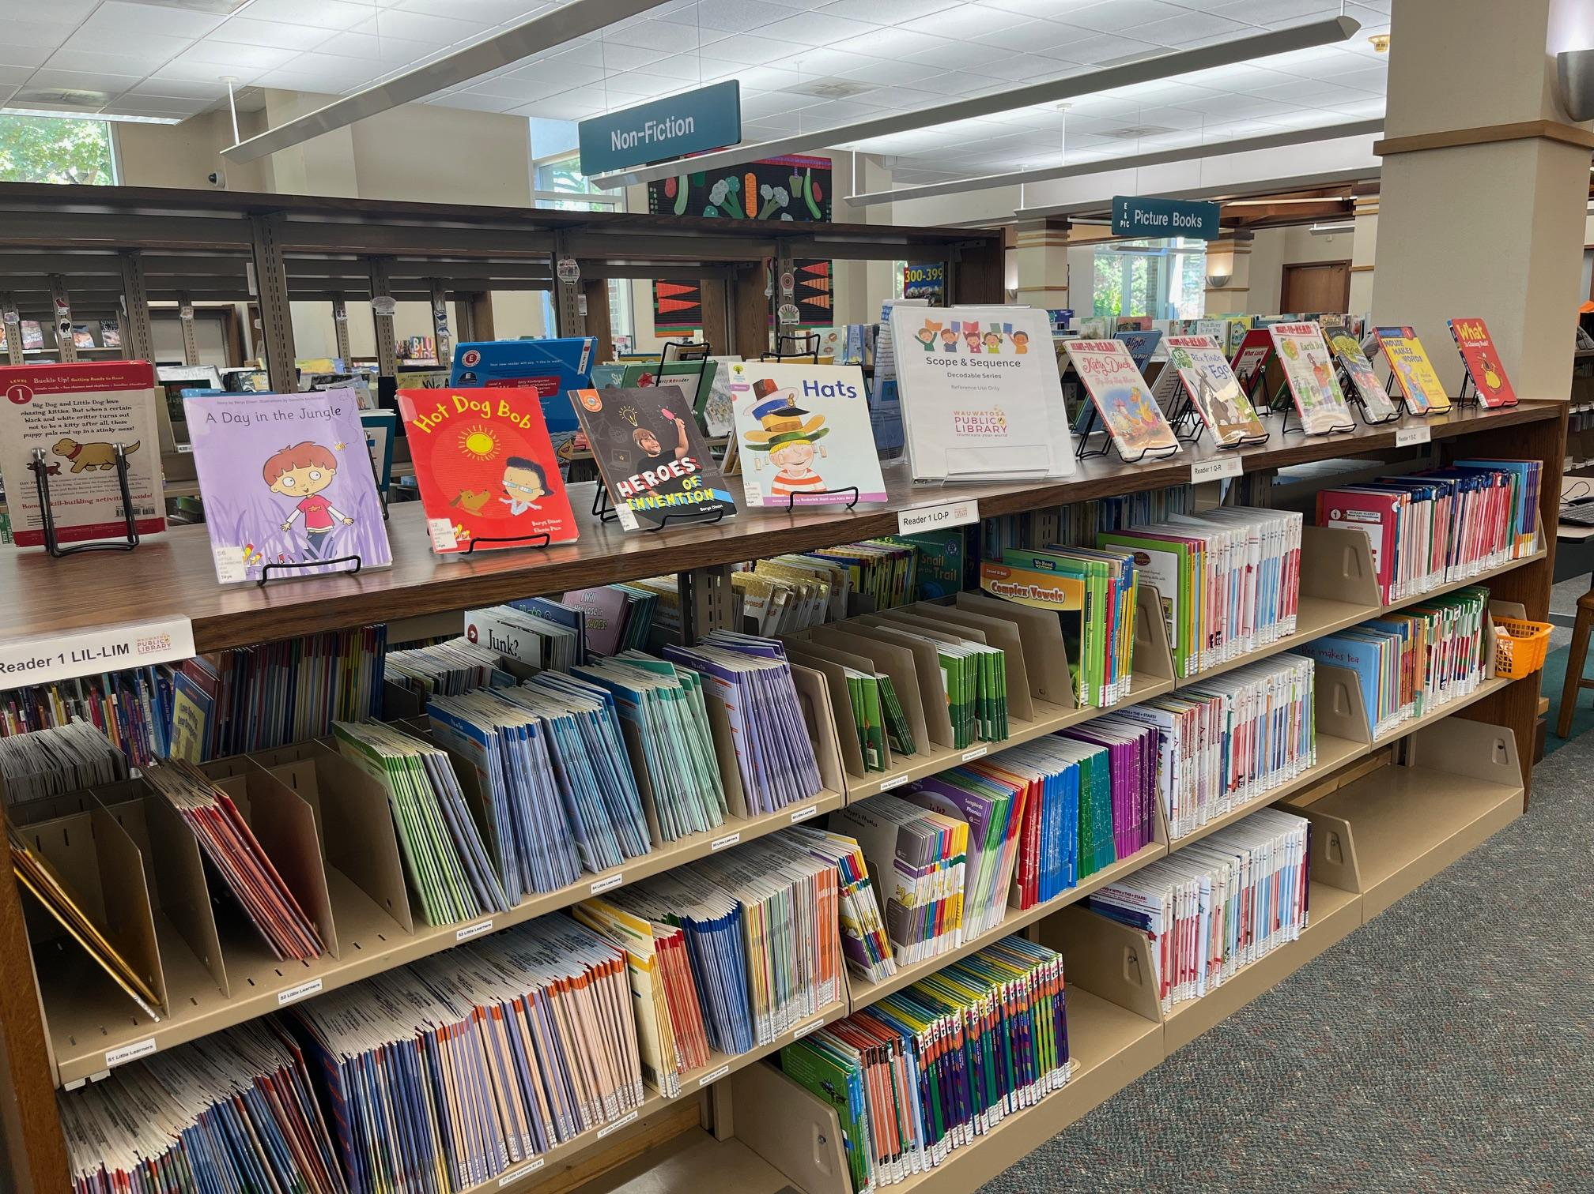

Slide 41
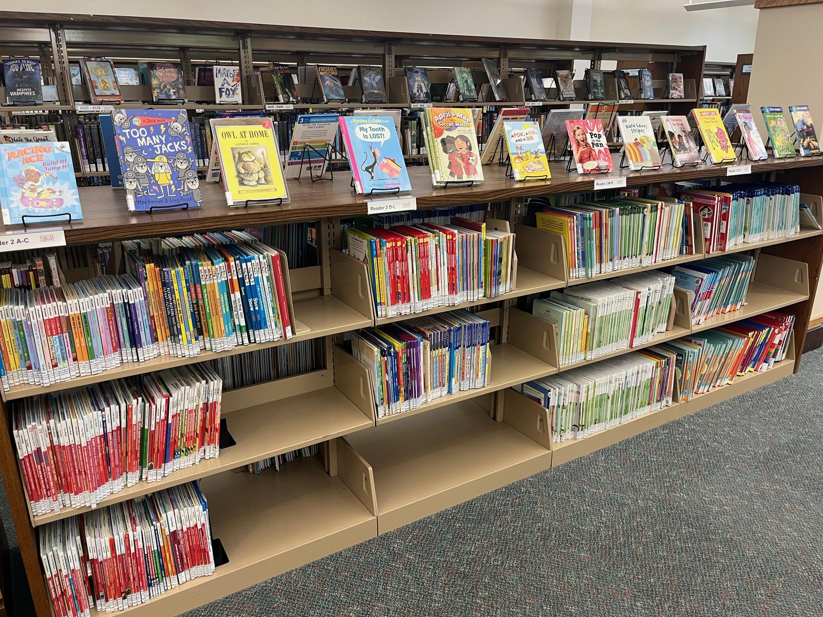

Slide 42
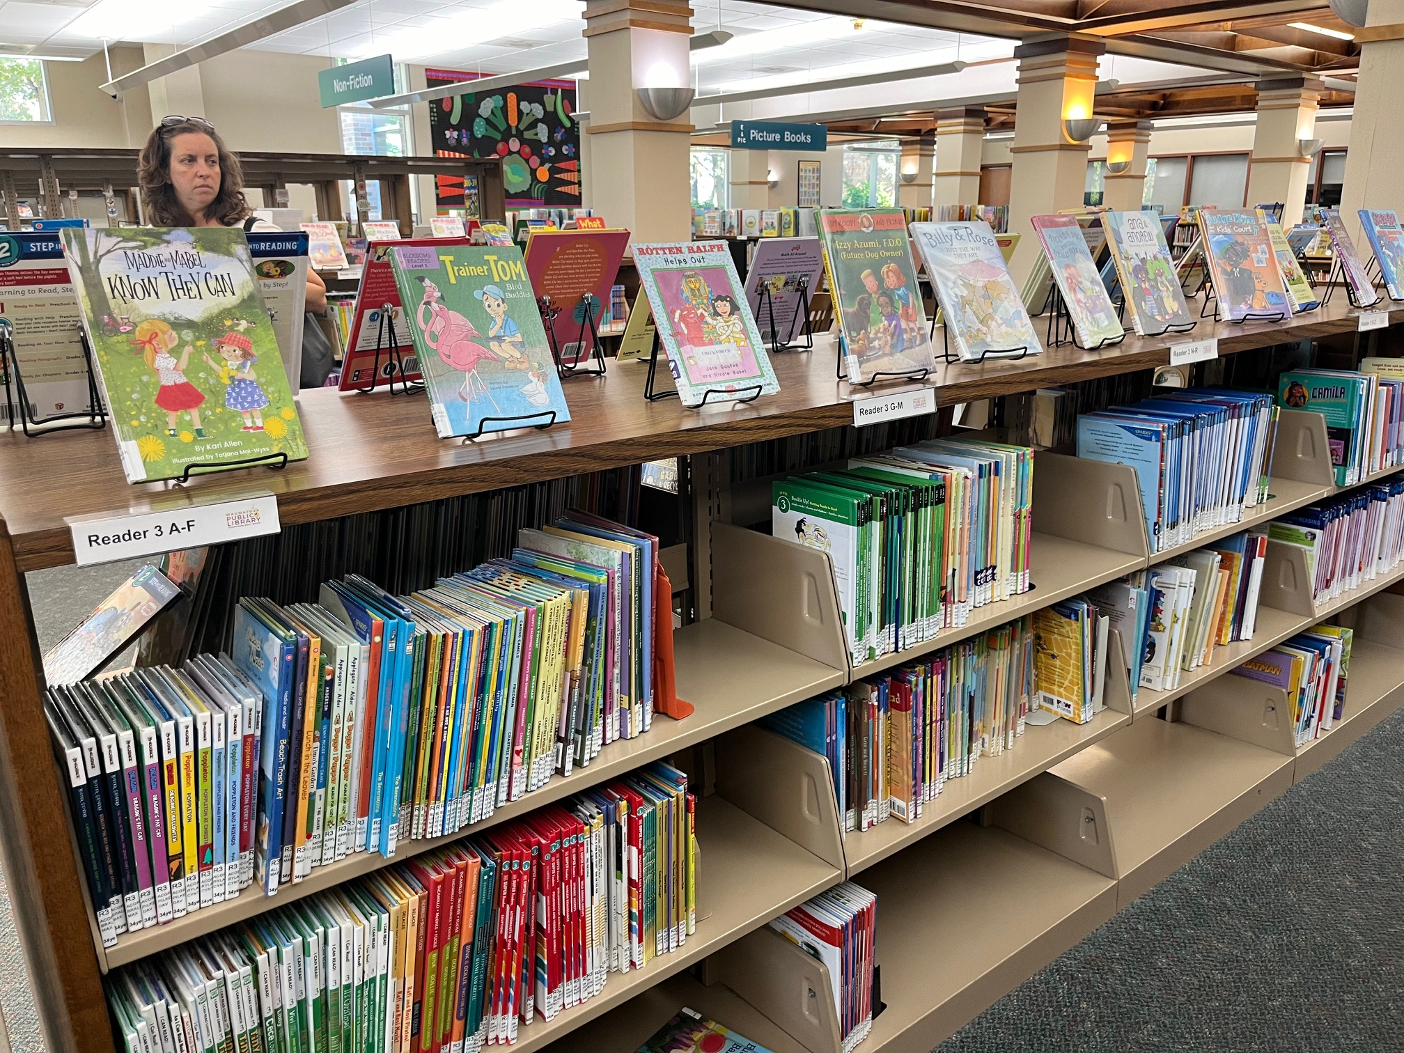

Slide 43
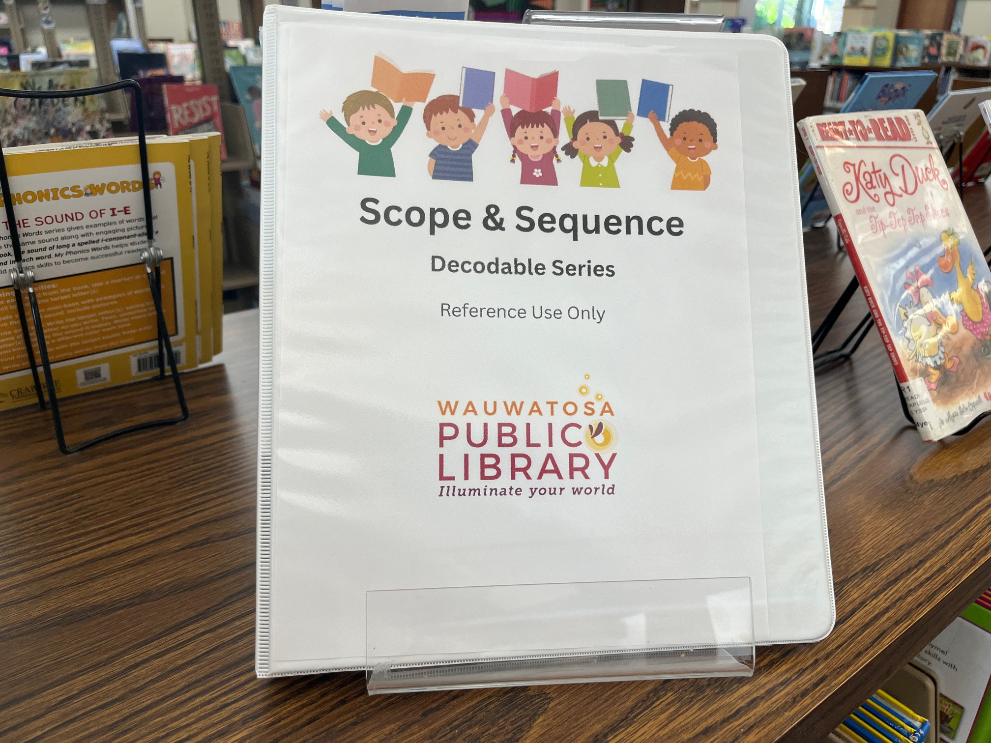

Slide 44
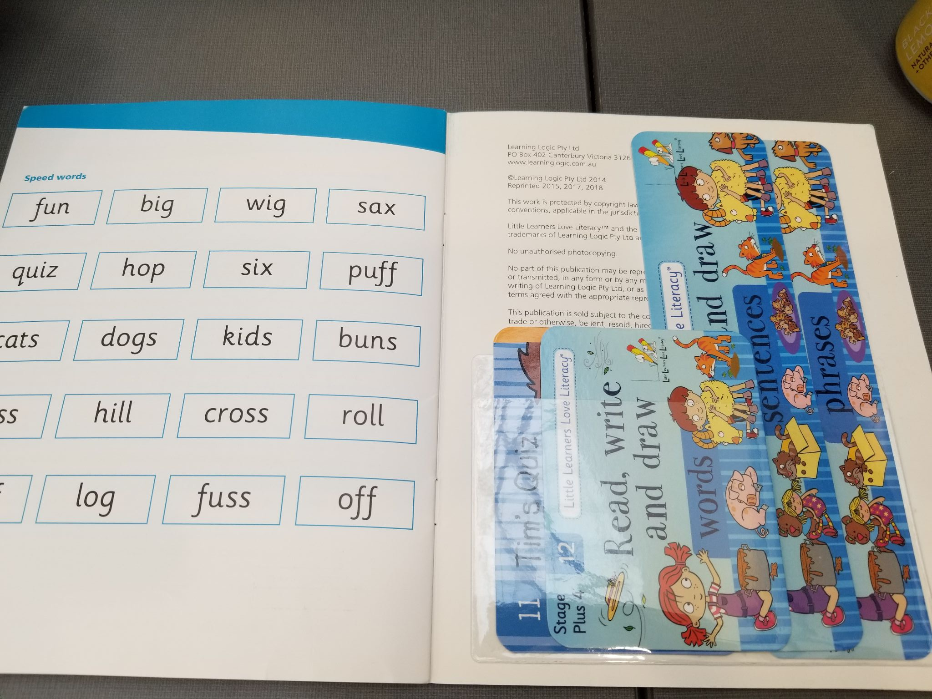
Notes:
Example of Little Learners cards that come with the set and are put in the back of the books

Slide 45
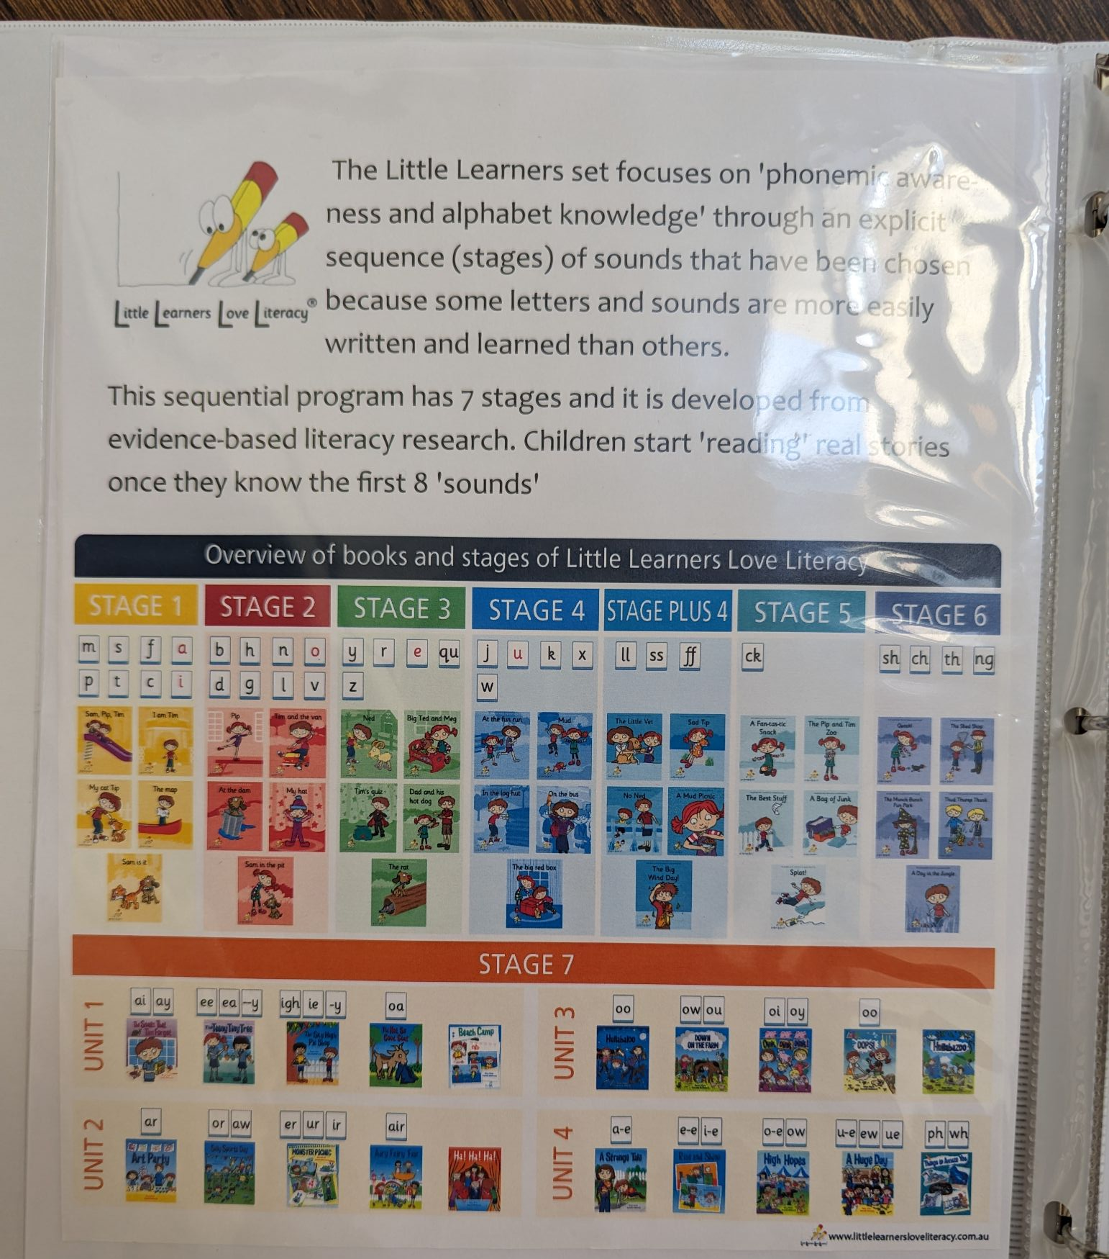
Notes:
Example of using the user guide ot Little Learners to help patrons use the appropriately

Slide 46
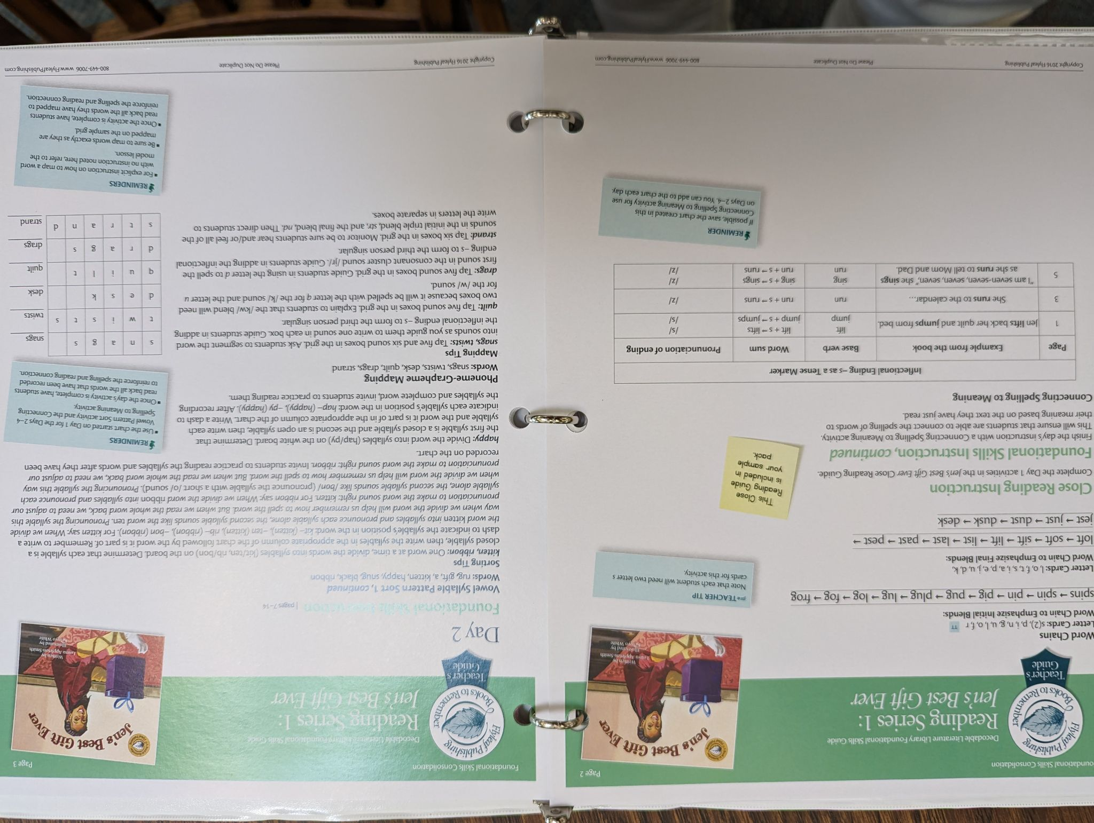
Notes:
Another page from the binder explaining how the FLyleaf decodable set is organized.

Slide 47
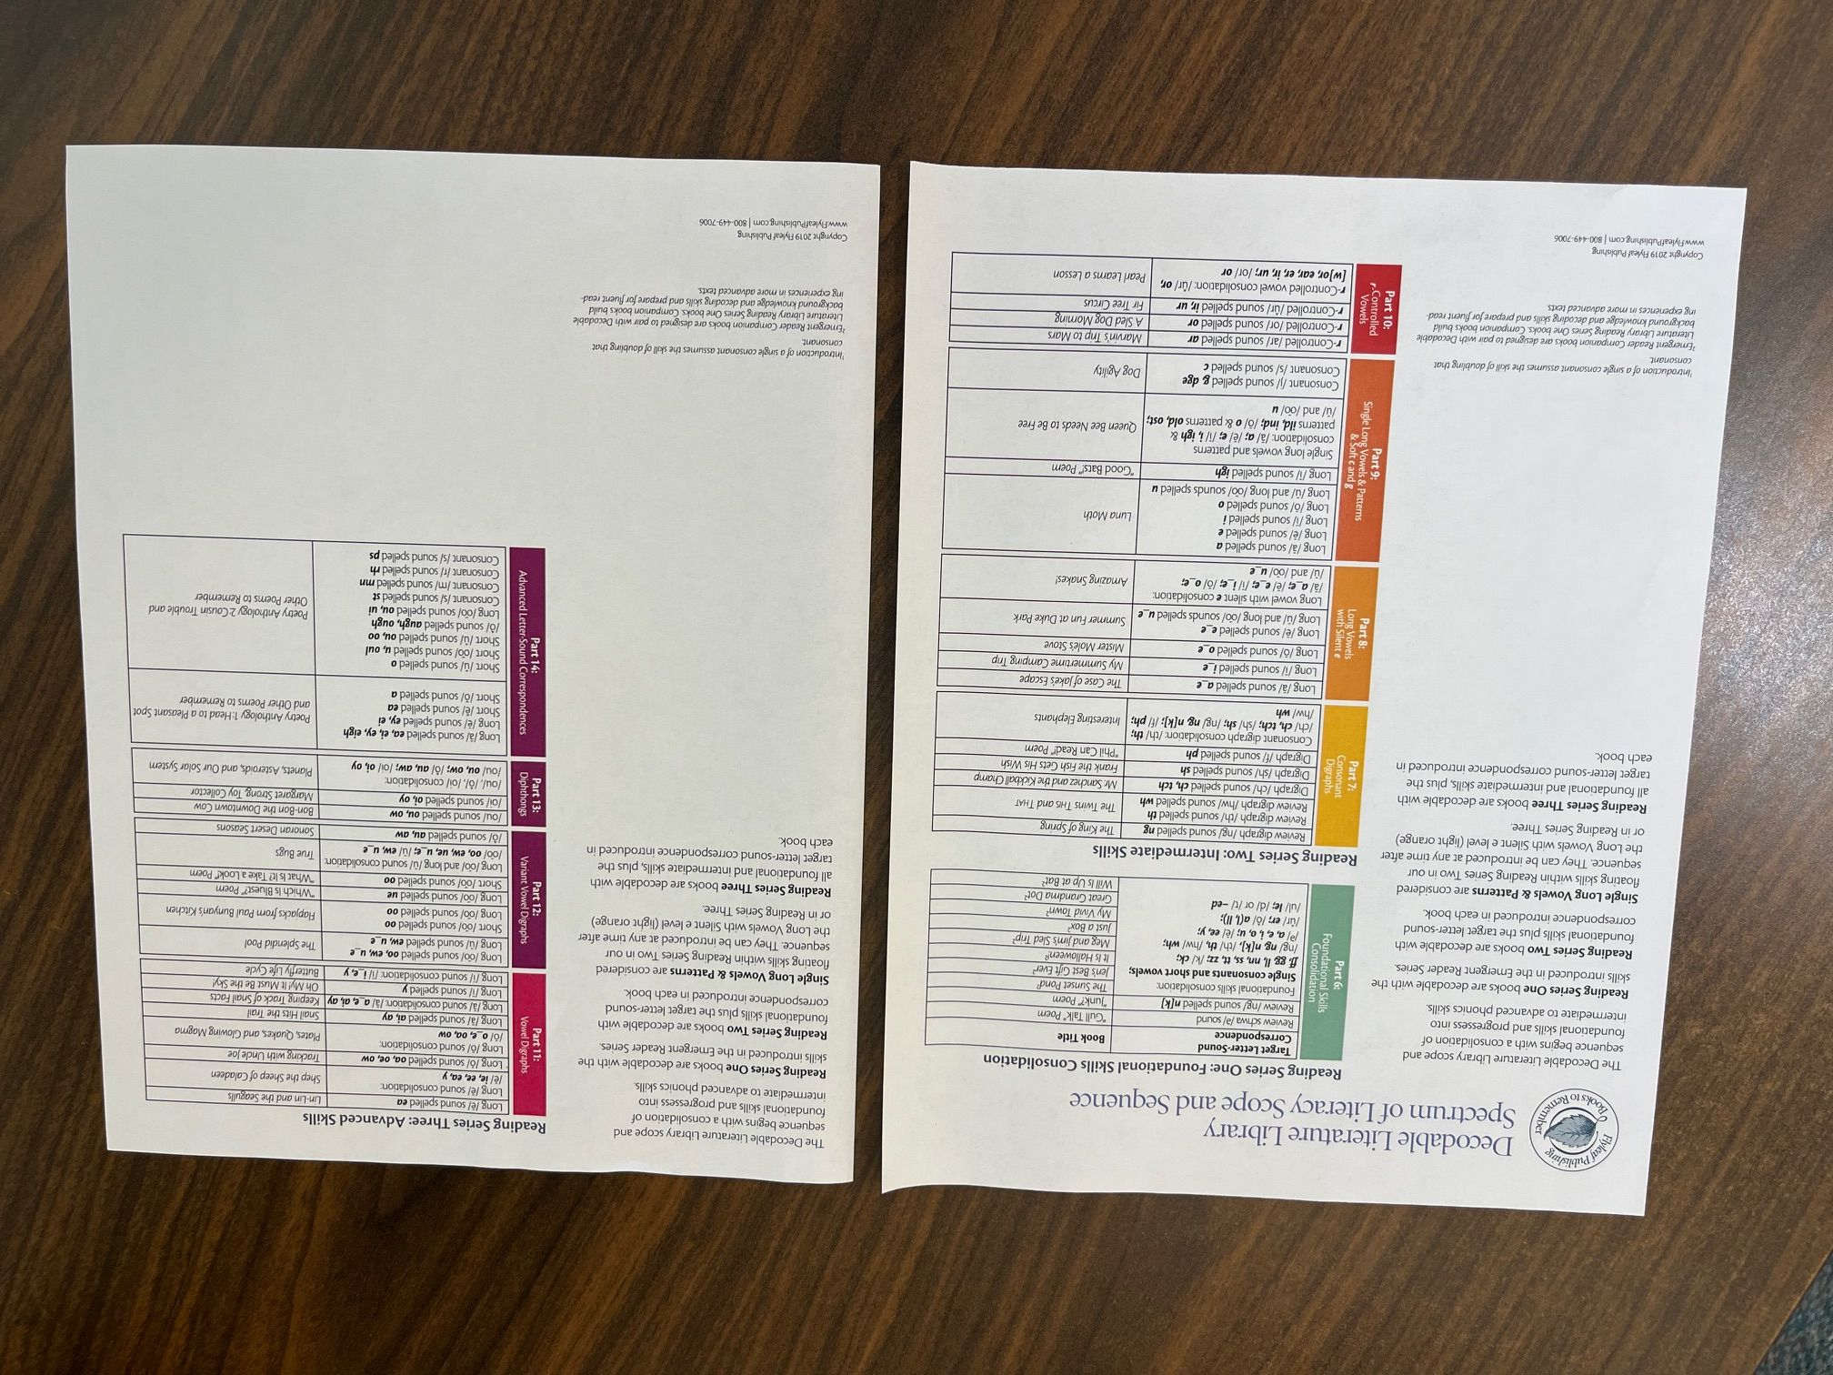

Slide 48
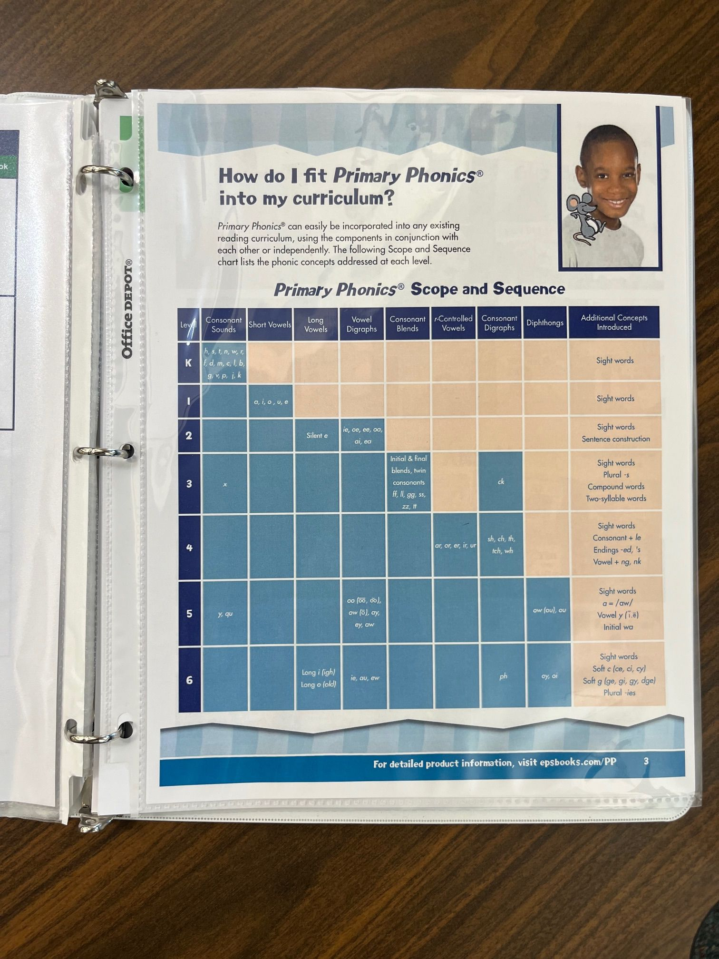

Slide 49
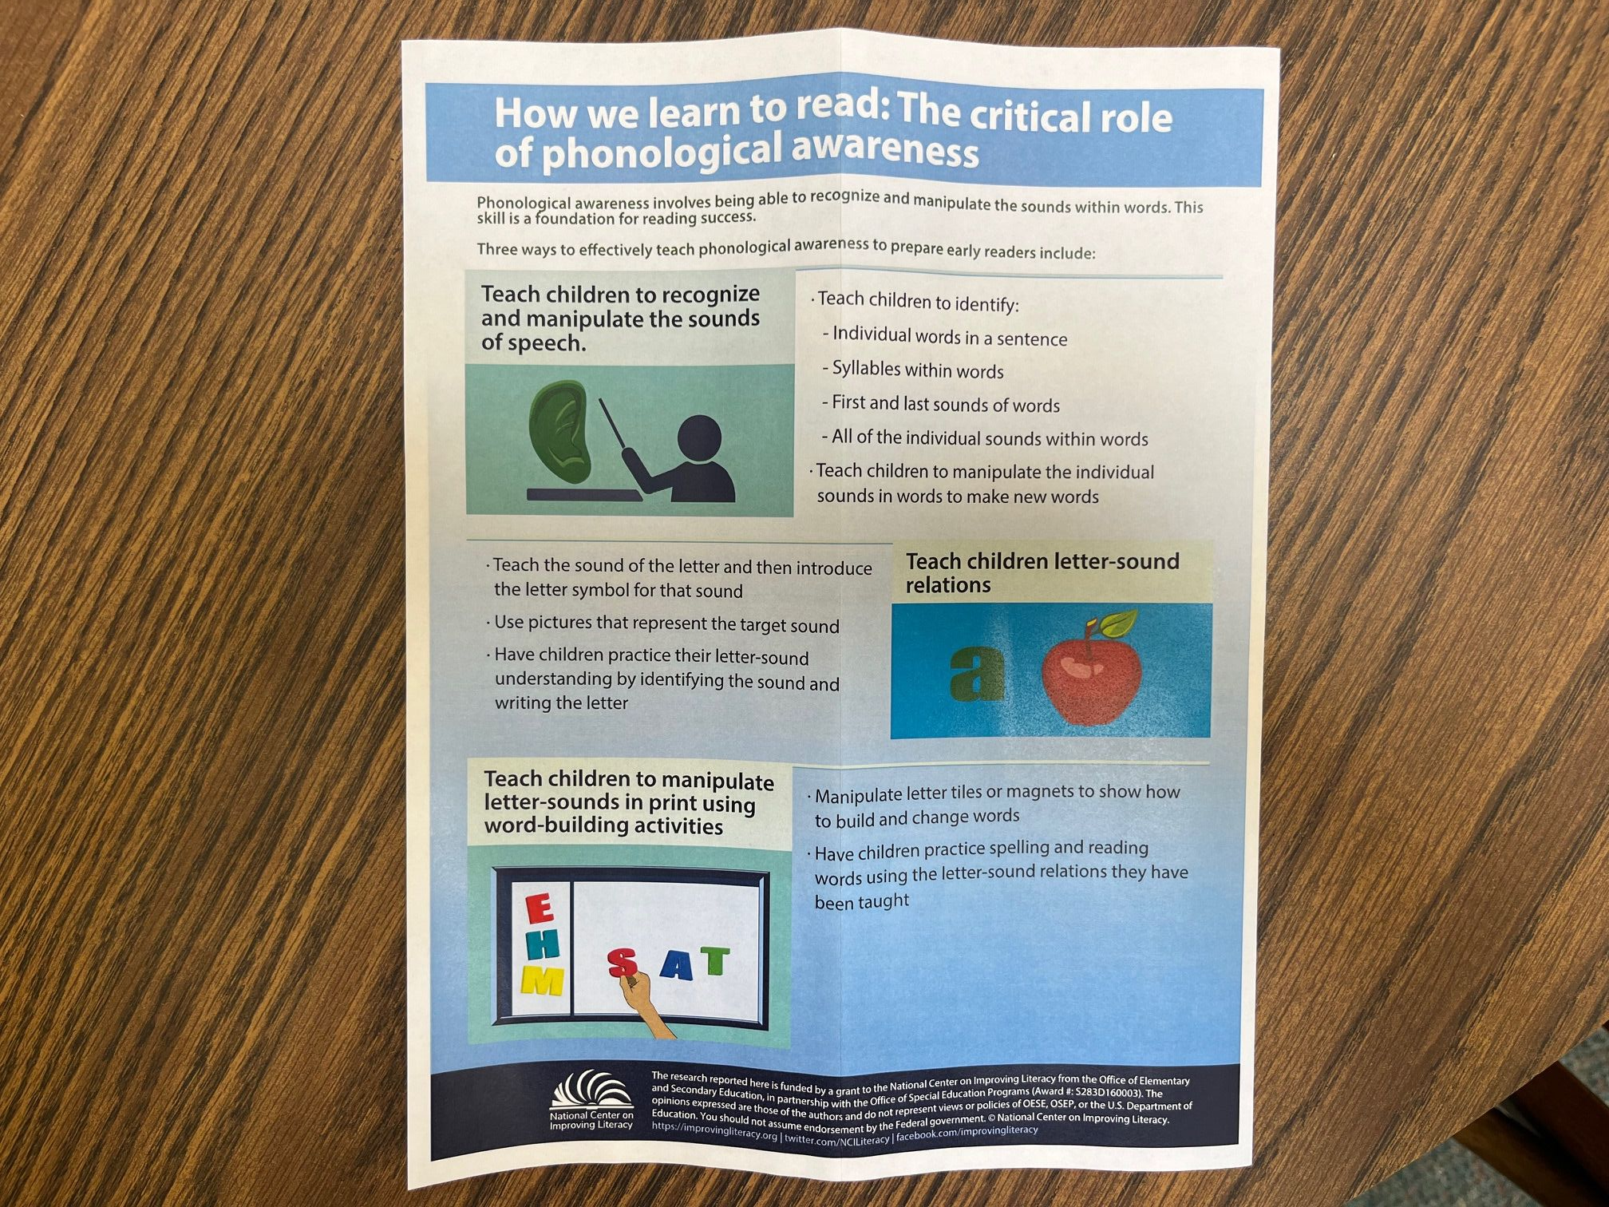

Slide 50
Wauwatosa Public Library Decodables
Benchmark* Bob Books Dandelion Launchers*
Little Honey Books* Flyleaf Little Sprouts
Little Learners (Pip & Tim and Big World Nonfiction)
Oxford Primary Phonics Dragon Egg Series
Moon Dog Series
Saddleback (Go Emerge; Go Decode; Go Engage; Go Excel)
*Specifically requested by Wauwatosa School District

Slide 51
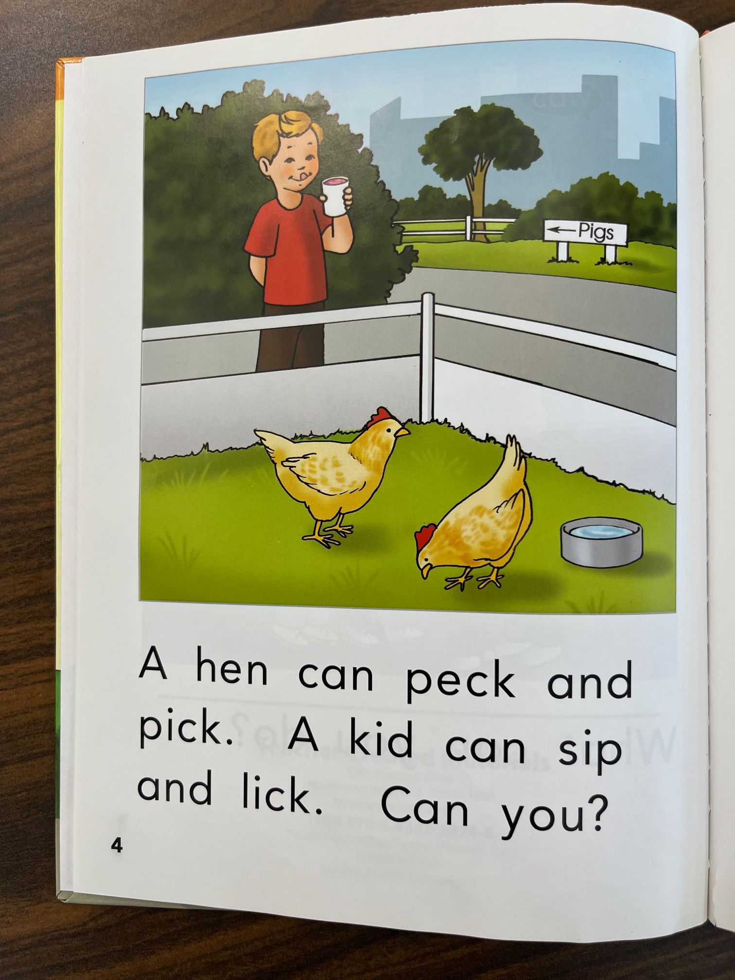

Slide 52
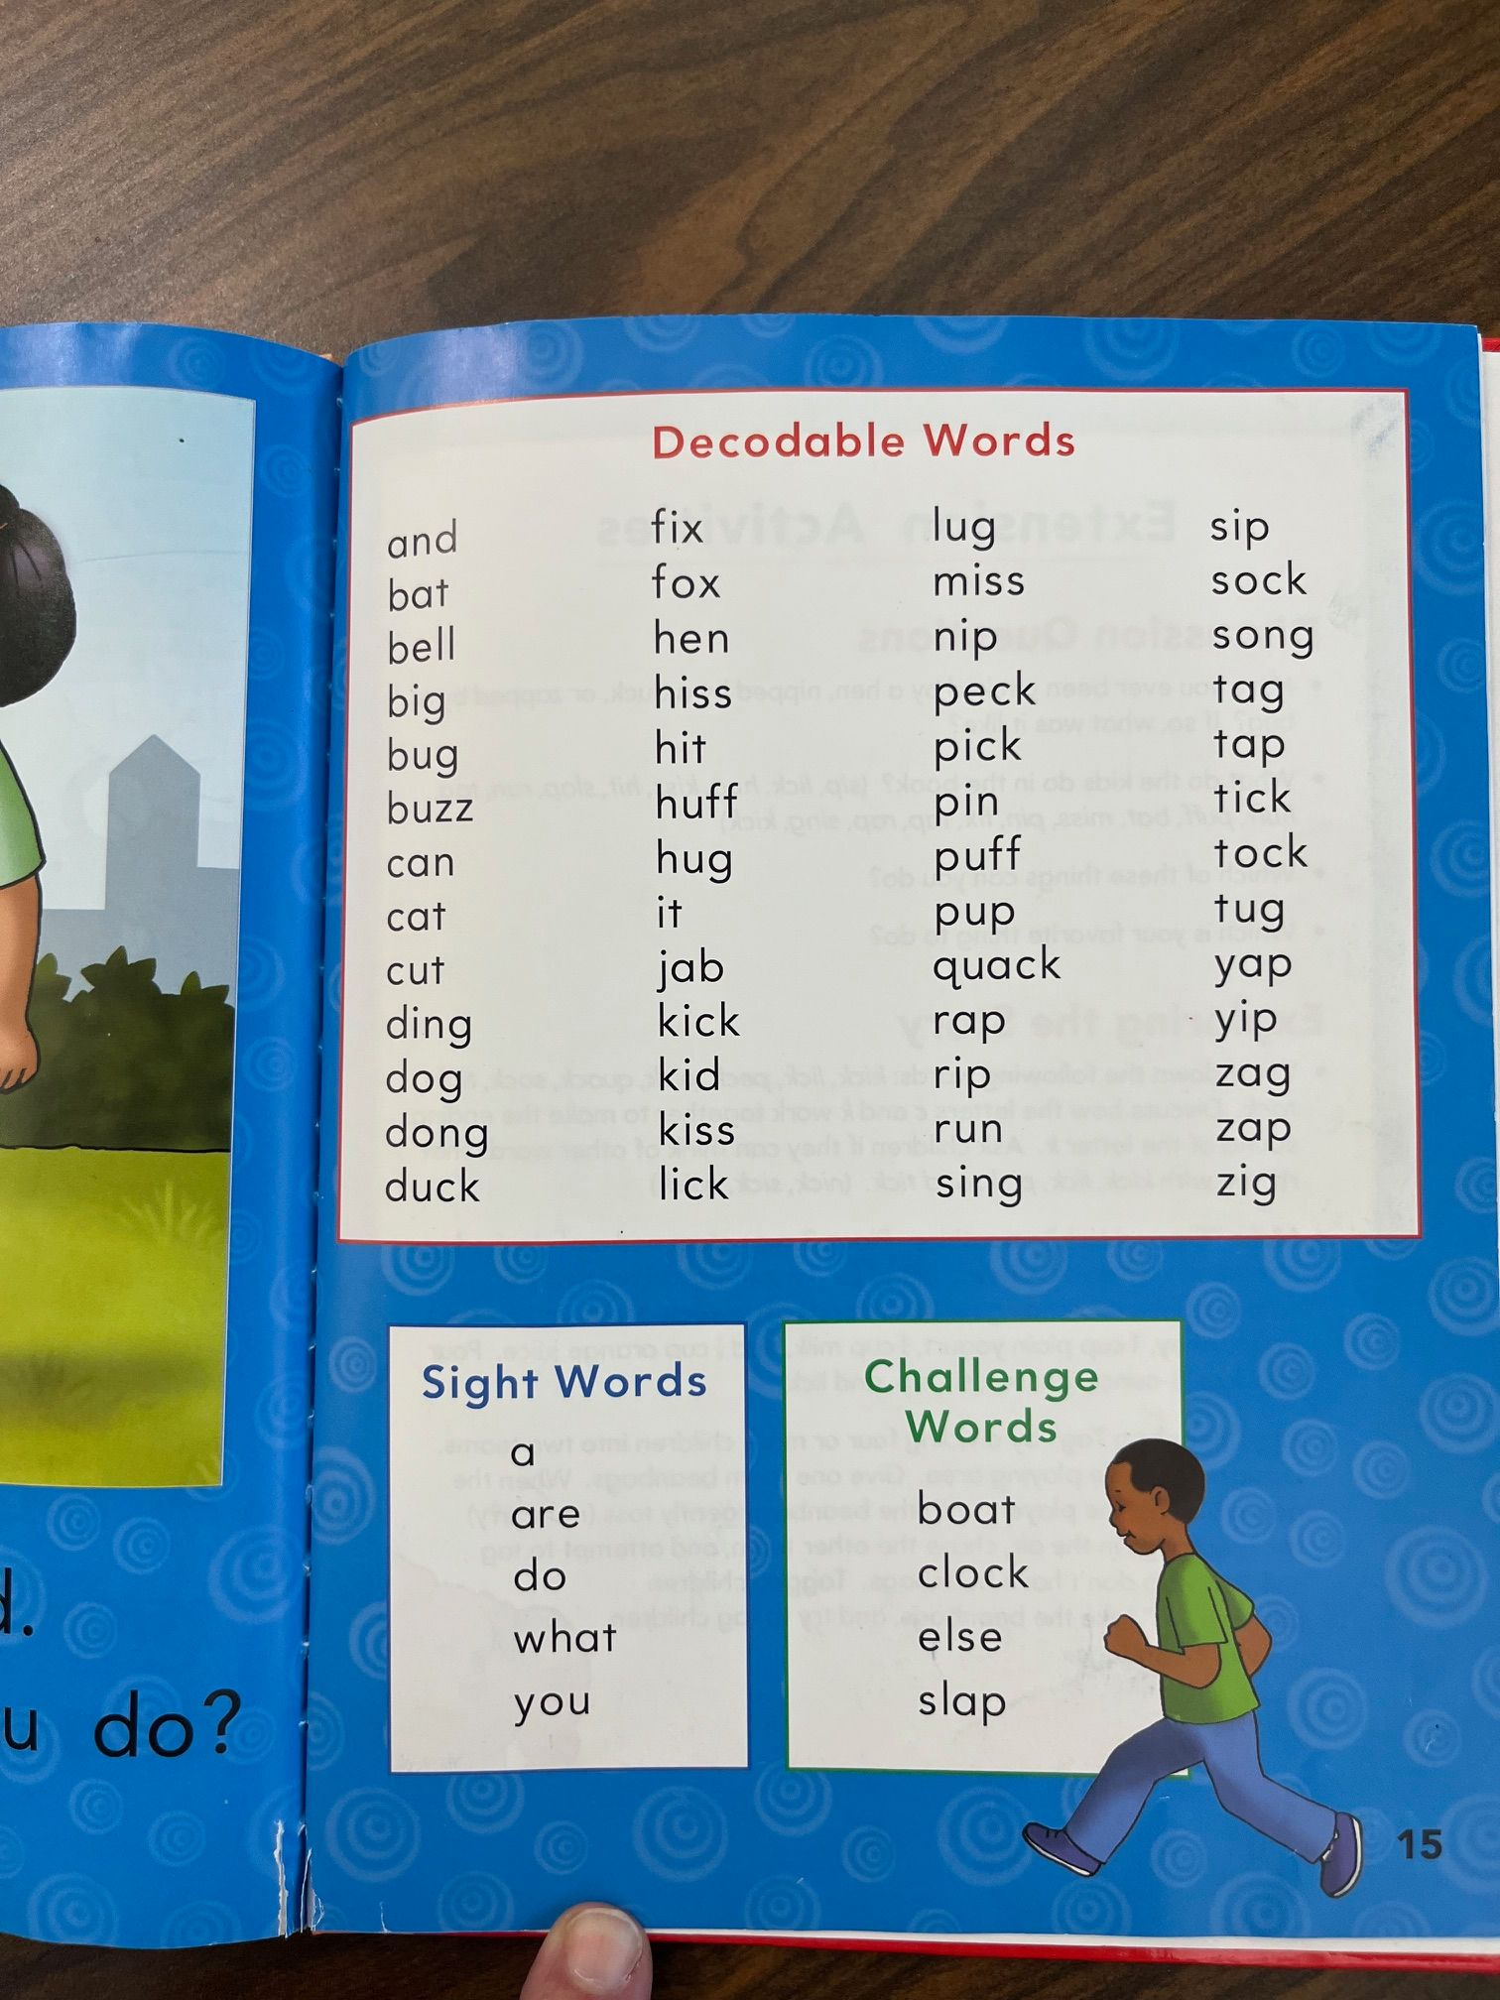

Slide 53
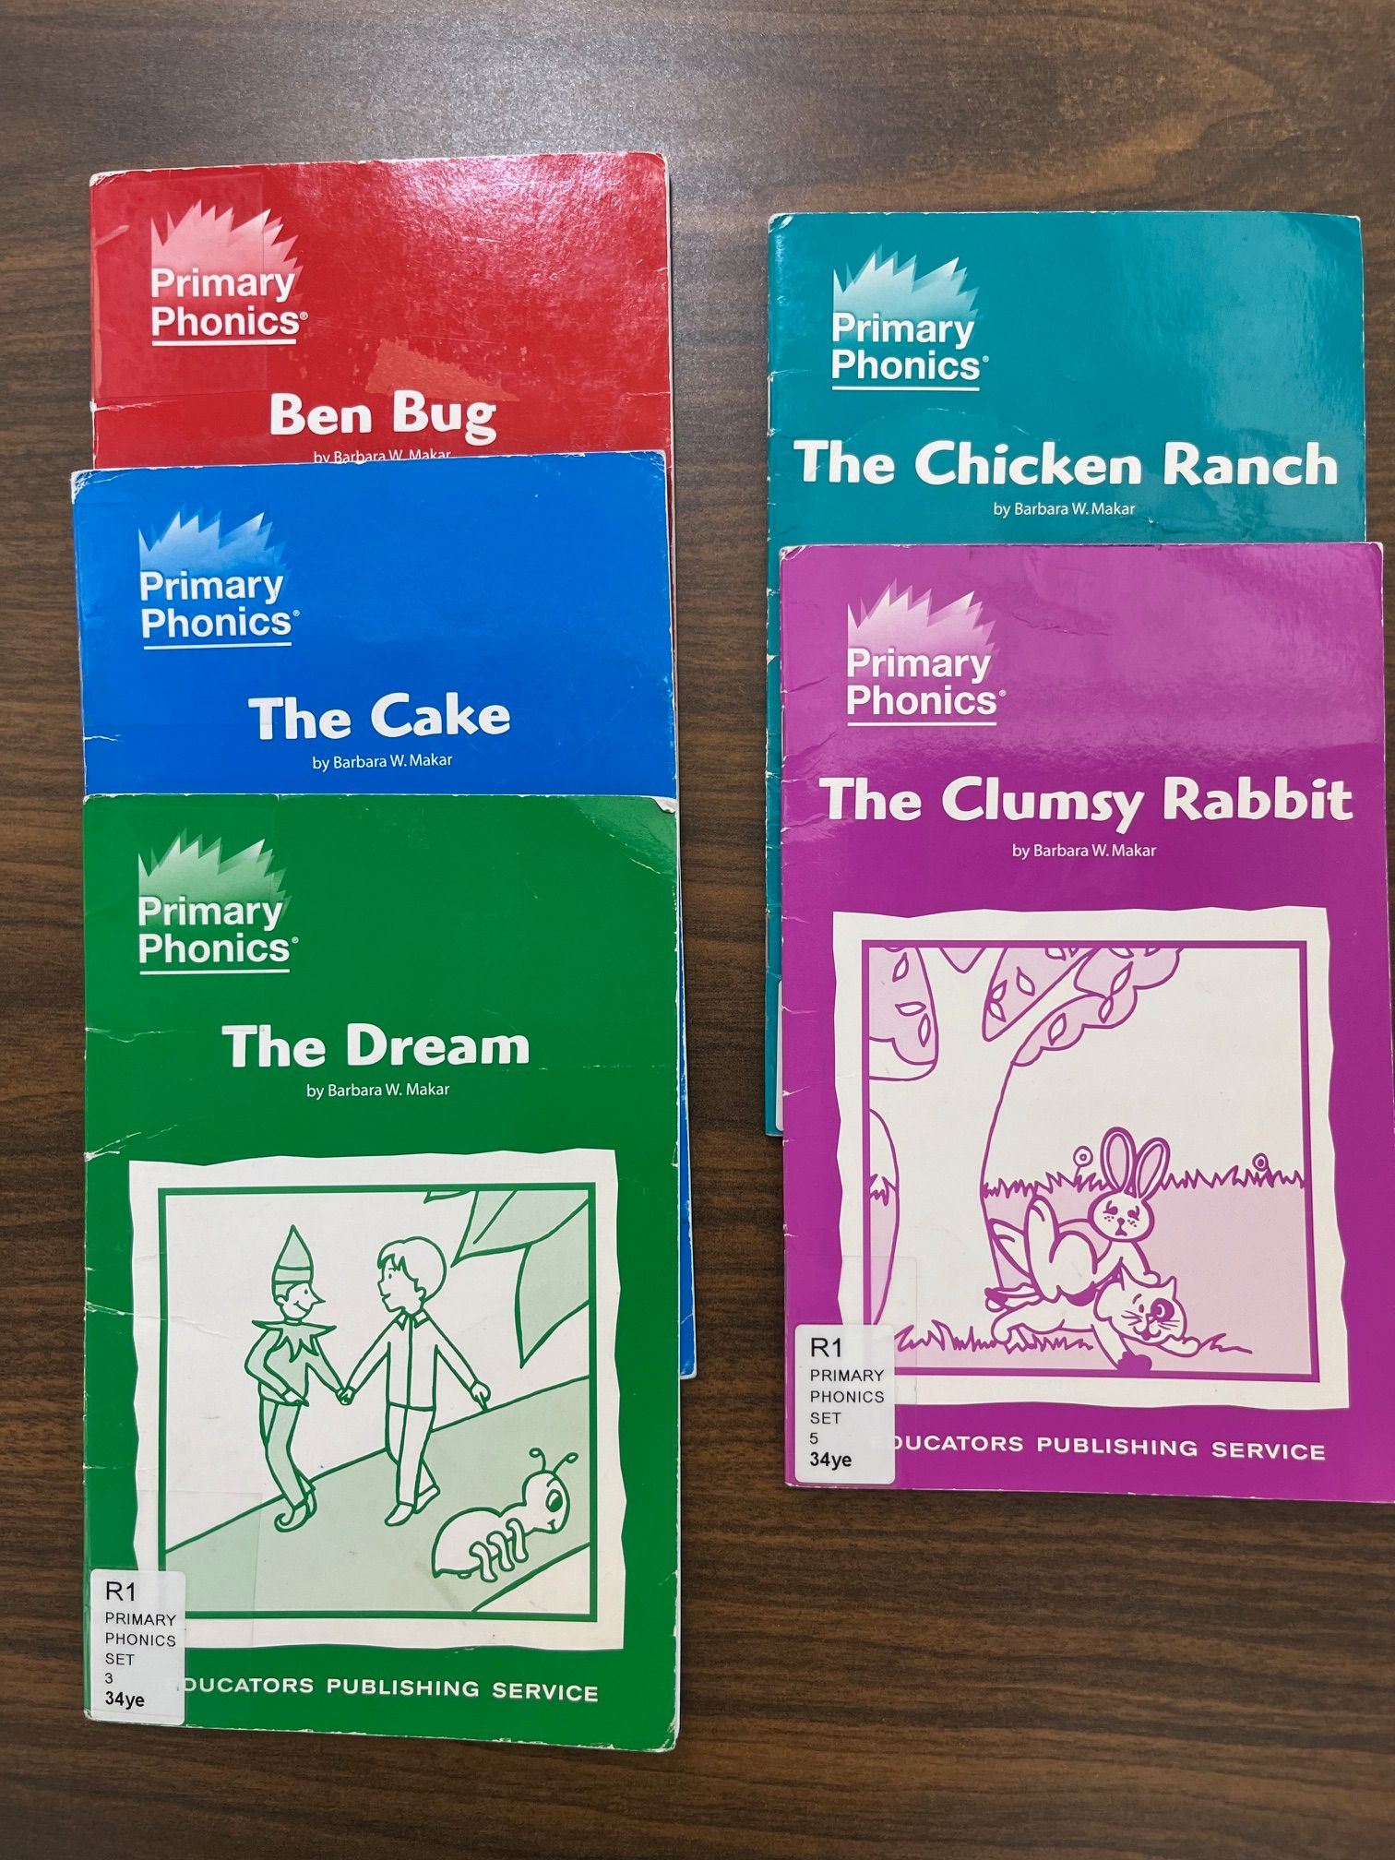

Slide 54
Encouragement from the Wauwatosa Public Library
Wauwatosa Public Library has built a substantial SOR collection to support literacy. We have become known by educators as the place to "shop". More importantly, we receive feedback from excited parents that their child is reading. As a public library, it is our responsibility to not only promote literacy, but give every child the opportunity, the right, to learn to read.

Slide 55
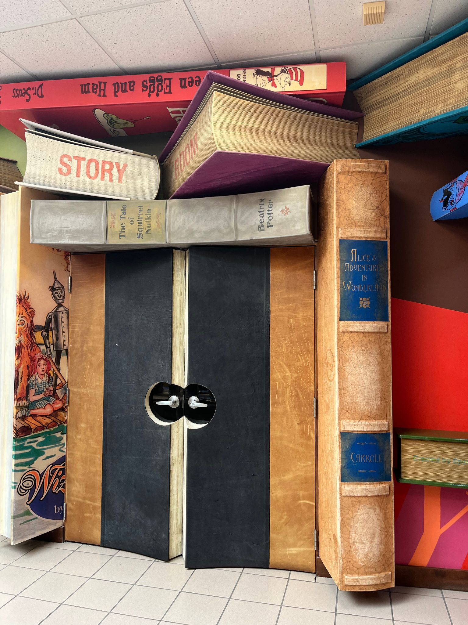

Slide 56
