Slide 1
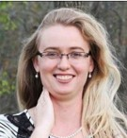
STEAM in Youth Services!
Emily Zorea
Youth Services Librarian
Brewer Public Library
SowingSeedsLibrarian.com
Notes:
Good morning! My name is Emily Zorea and I am the Youth Services Librarian at Brewer Public Library in Richland Center Wi.
I am very excited to be here today and share some ideas for high interest programming that I feel very confident that you can use in your library right now, regardless of size and budget.
I did not think I would ever go into libraries because I thought all the jobs were taken, and why would any youth services librarian ever want to retire, their job looked like so much fun.
I was hired at Brewer Public Library right before I was married in 2015 as a library assistant, and during my honeymoon I was sent an email by our library director at the time letting me know that our current youth services librarian was leaving because she was going to have a baby, and that the library was accepting applications for the new youth services position.
I applied, did not know if I would be able to do this job, the job that I always wanted, but I was hired, and I know that I have now found the career that I want to dedicate my life to.
Richland Center is a small community, and we will take more about that later, but when I go to any public place, like Walmart, kids see me there, and they know me by name. We see horrible things happening in the news, and it can feel that power of true evil is more than we can possibly overcome, but I think that we are forgetting the very quite power of being positive role models in children’s lives. If we know them by name, if we establish a trusting relationship with them, if we show them at we care about them, that we can supply them with any book they want, if we can offer them programs where they can learn mastery, that is something powerful that the kids in our community can hold onto, and it may be enough to stand in the gap for them and reveal to them that there are other ways of living their life.
I have planned programs and no one shows up. I have planned programs and only one kid shows up. I have planned programs and 20 kids, 40 kids, 400 kids show up. So, I get it. But, what I found that our most successful programs are the ones that are accessible to multiple age groups, that can be scaled down or made more challenging, and STEAM is a great programming choice for those programs.
All of the STEAM programs I have lead as family programs where I have multiple age groups working together at one time, and as outreach programs in schools for grades K-5. And, these programs were all winners.
STEM (Science, Technology, Engineering, and Math)
Programs will either focus on one of those four subject areas, or more holistically incorporate several of those areas at one time.
We have a very small budget. My limit is $0.30 per child, and often less.

Slide 2
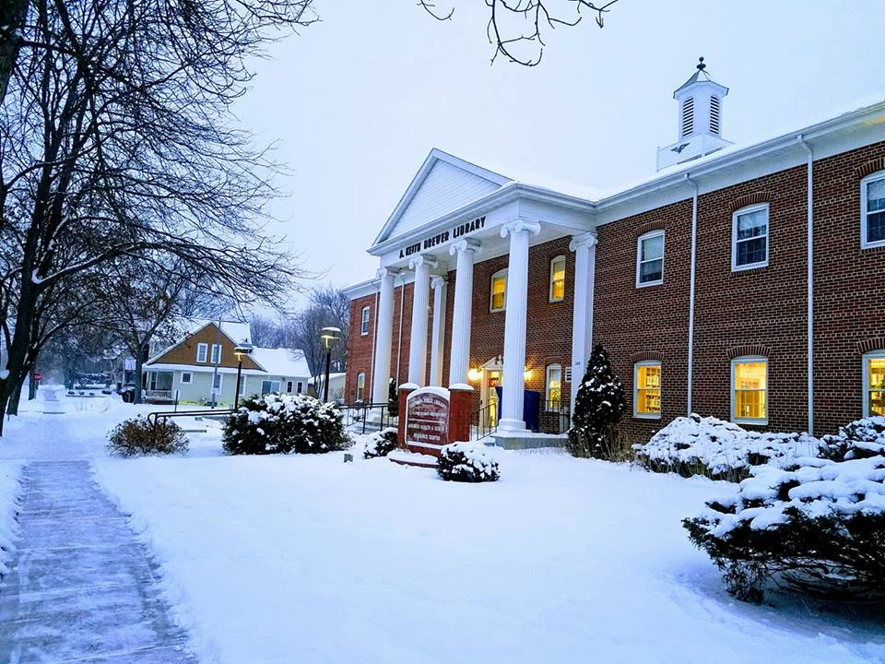
Notes:
This is our Brewer Public Library
Richland Center is in a city of 5,000 people surrounded by very rural communities
Our service population is 15,000.
Most kids need to be driver to the library by a parent to be able to participate in programs. (Sound familiar?)
When I began, our library only had 25 programs for youth throughout the whole year. I decided that our community deserved more than that, so I added many more programs that welcomed whole families to come to the library, and our programming numbers skyrocketed.
In 2016 we had 309 programs with 9,500 children attending.
In 2017 we had 384 programs with over 10,000 youth attending.
This is just me. I lead and organize all youth service programs and we only have a budget of $500 for youth programming.
So, all the ideas I am going to share with you are very cheap, and they can done by a very limited staff, and I feel confident that they really can be duplicated anywhere.

Slide 3
Agenda for today ☺
- STEAM Family Programming
- Teen Specific Programs
- Community Grants
- And if we have time…a few more fun ideas!

Slide 4
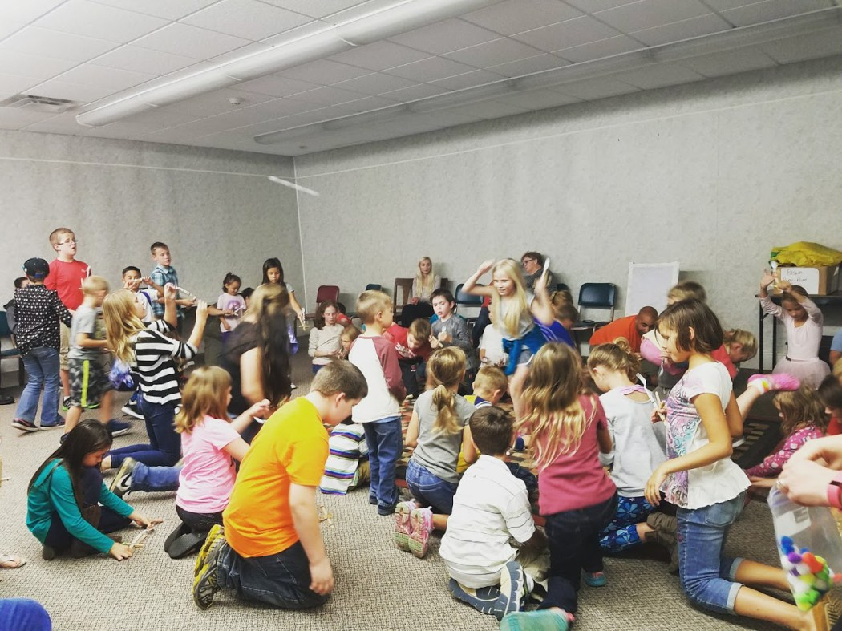
Start with “Why?”
Notes:
STEM as a Community Education:
-When I began to plan out a long-term plan for our STEM Workshops, I was learning that research backed up the model of what I had in mind, which was to use the public library as a place where our community, youth, parents, siblings, and strangers, could come together to explore using informal experiences.
Youth only spend 5% of their lives in the classroom.
Most learning, most science, is learned outside of formal education.
All learning positively influences the classroom experience.
Research shows that when families, schools, and community work together to support learning, students perform better academically.
In fact, the greatest factor that affects youth’s immediate and later success is the family’s attitude that learning is a positive experience.
Libraries offer a physical place to bring our community together to support the learning of youth while maintaining a family holistic program.
Research:
http://www.afterschoolalliance.org/AA3PM/STEM.pdf

Slide 5
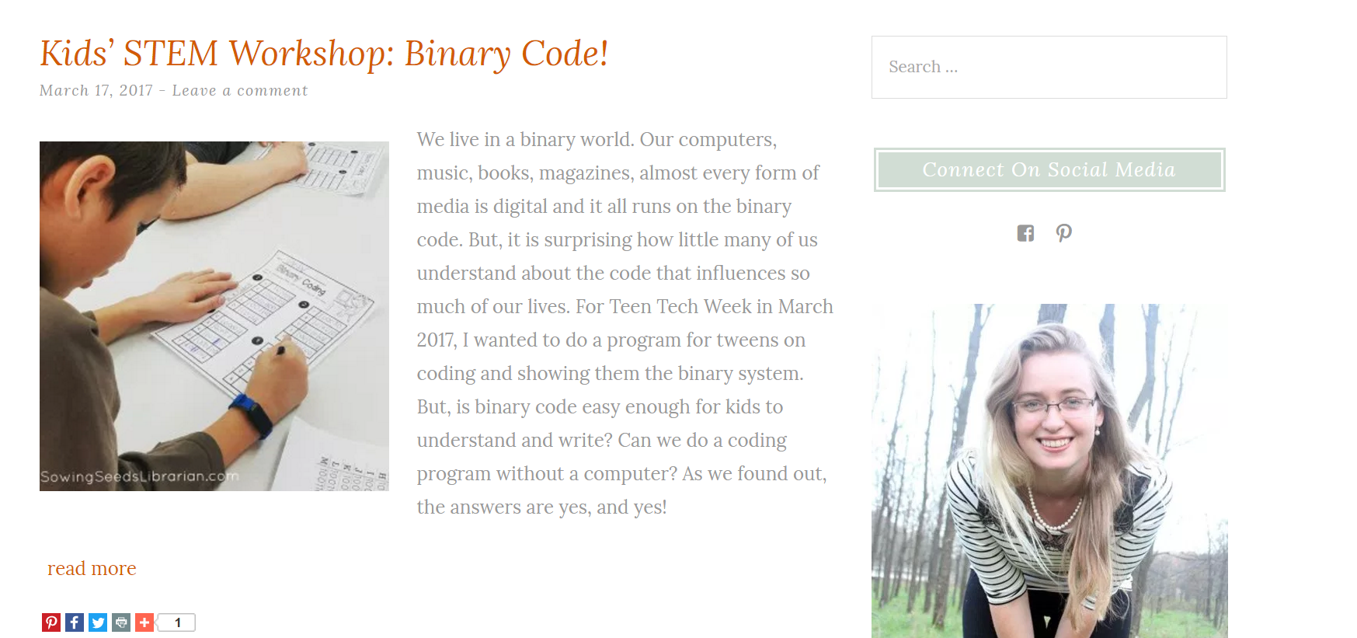
Notes:
And all the information is…
I wanted these ideas to be easily duplicated.
Blogs were my mentors, wanted to pass these ideas along.

Slide 6
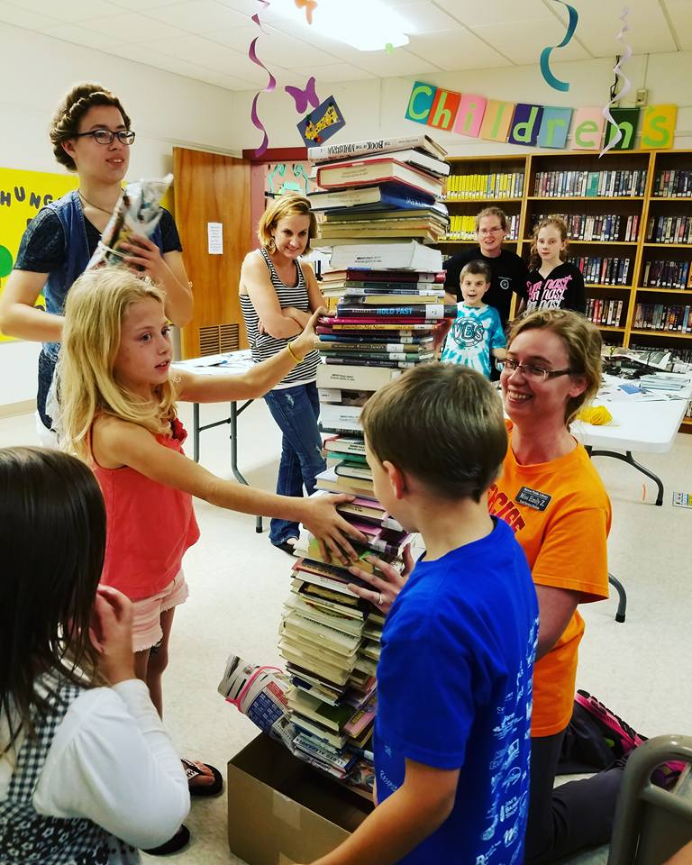
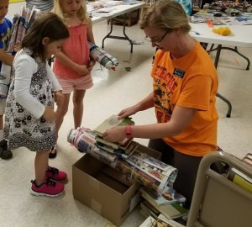
Bridge Engineering with Newspaper
Notes:
Bridge Engineering with Newspaper:
1st program
$0 to offer
Paper was donated from print shop

Slide 7
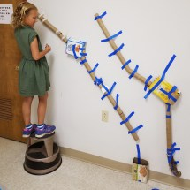
Marble Drops
Notes:
Marble Drops
Great for young and older kids
Toilet paper rolls, masking/painters tape, cardboard boxes
Inclined planes, simple machines, gravity

Slide 8
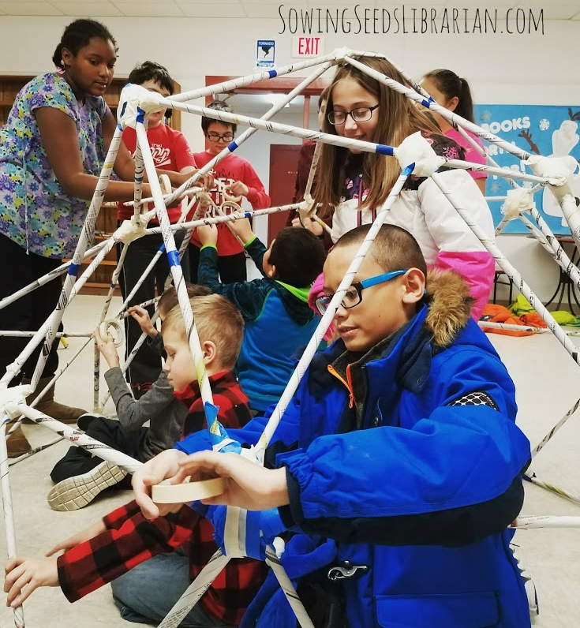
Geodesic Domes
Notes:
Geodesic Domes
Newspaper and masking/painters tape

Slide 9
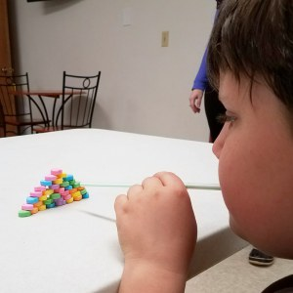
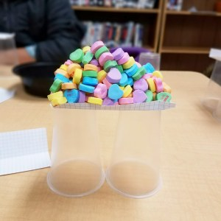
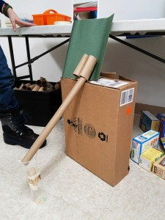
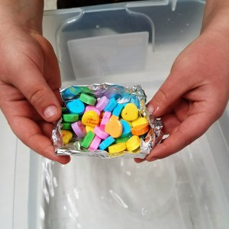
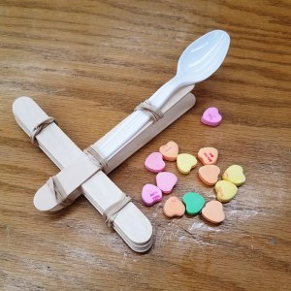
Valentine’s Day STEM
Notes:
Valentine’s Day STEM
Use Candy hearts for every station (5 stations)

Slide 10
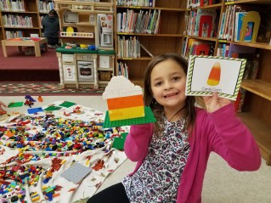
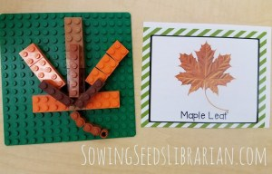
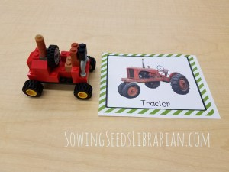
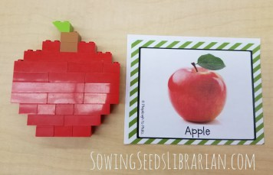
Fall Lego Building Challenges
Notes:
Fall Lego Building Challenges
Download the FREE Fall Lego Building Challenges from the STEM Laboratory
https://thestemlaboratory.com/fall-lego-challenge-cards/
Set out Legos on the floor on a blanket for easy clean up.
Scatter challenge cards
Invite kids to build the picture

Slide 11
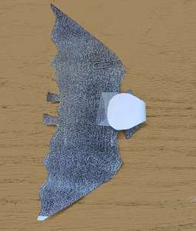
Bats in Flight
Notes:
Bats in flight
$0
All you need is the template and some paper clips, scissors and tape

Slide 12
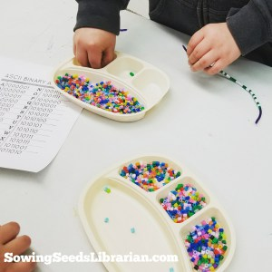
Binary Code
Notes:
Binary Code:
$0 we had all the supplies on hand.
You can order 6,000 Perler beads on Amazon for $13.
Need downloadable- Binary alphabet, Binary Coding Sheet, and the Binary numbers

Slide 13
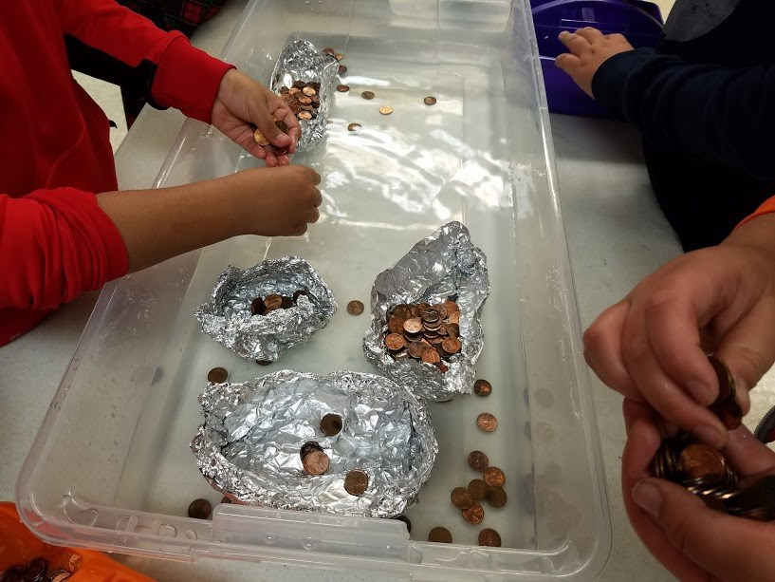
Float or Won’t-Boat Building
Notes:
Float or Won’t
Cost $15 for tin foil (2 rolls of 180 feet each roll)
Underbed storage containers $80 worth. But, we will be able to use these again.
$20 in pennies…but we will be able to continue using these again and again
Buoyancy, density, and the Archimedes' principal

Slide 14
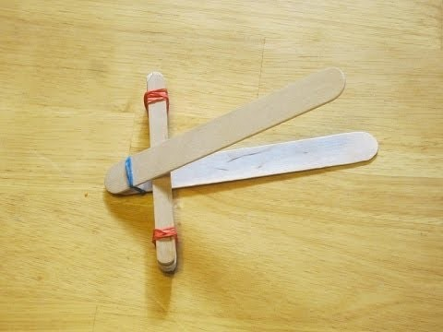
Catapults
Notes:
Catapults
-our highest attended program
-

Slide 15
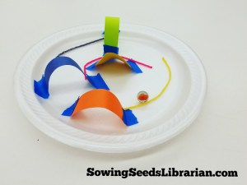
Marble Maze-Push and Pull Physics
Notes:
Marble Maze-
Cost= $0.25 per child.
Supplies: Foam plates, marbles, painter’s tape, paper scraps, Wikki Sticks

Slide 16
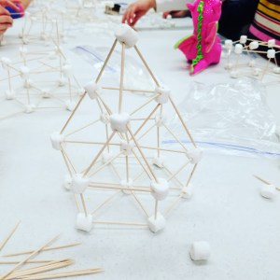
Marshmallow Igloos
Notes:
Marshmallow Igloos
$0.30 per child
Need: Marshmallows, toothpicks, paper plates to carry creations home, sandwich bags to pre-portion out how many marshmallows each child will receive.
I used 7 10 oz. bags of mini marshmallows 5 boxes of 500 count toothpicks Sandwich bags Paper plates to build on (and carry their creations home!)
I was able to divide all these supplies into 55 bags to serve 55 children.

Slide 17
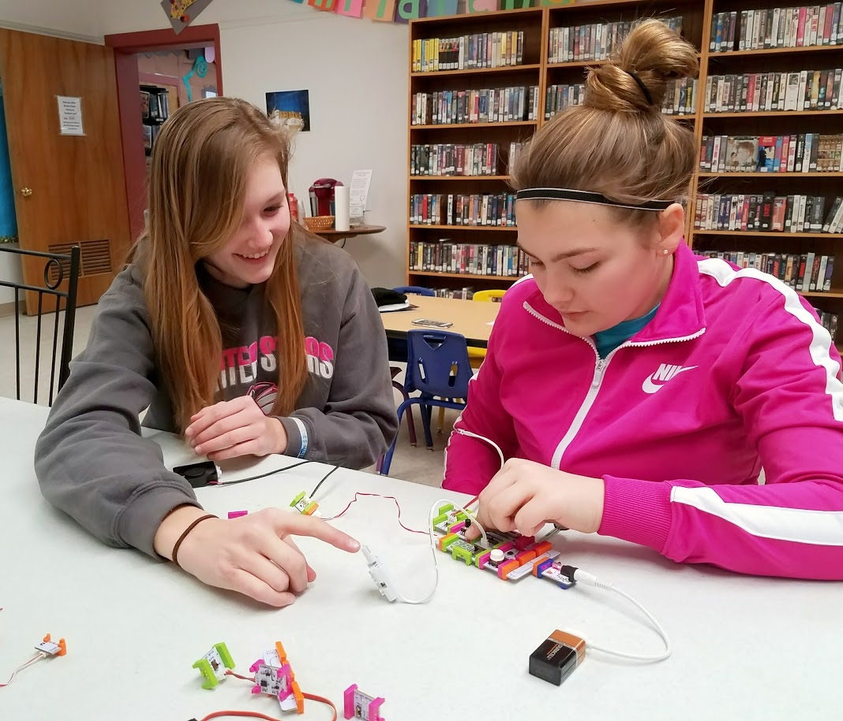
littleBits

Slide 18
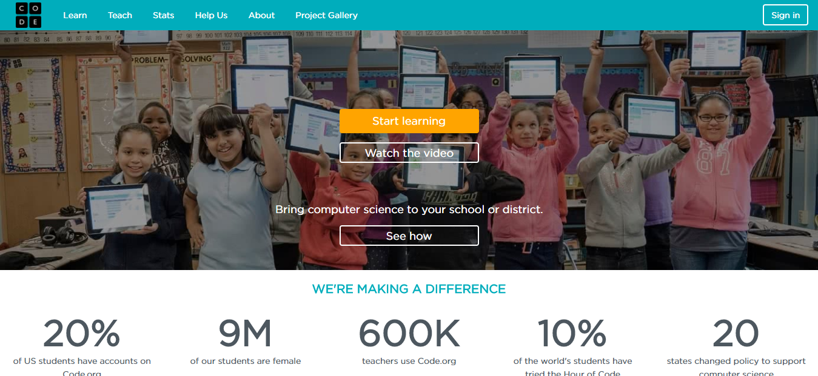
Coding with Code.org
Notes:
Coding with Scratch
Code.org
A lot has been said about coding in the library world over this past year, and Wisconsin is leading the way in bringing coding education to our public through public libraries,→ very exciting!
How does coding fit into public libraries? We have a mission to be responsive to our community’s current and future education needs. 71% of new STEM jobs are now in computing, but only 8% of graduates are in computer science fields.
Your coding program at your library can give job training in coding to adults, or spark an interest in a young person that they will continue being curious about throughout their formal education, and may even choose as a career path.
What is coding? The best way to understand coding is to think of it as a literacy. Just as learning how to read print text gives children and adults a commination tool that the majority of their lives will be based on, learning how to write the code that is behind every website, app, or digital devise will also help our youth and adults learn and practice logic, expression, and creativity.
I do not have a computer science background, but for the past month I have been leading coding programs as an after-school activity at the library using code.org. All of my lesson plans are on my blog. I will also be using another curriculum, Google CS First beginning next week as an outreach program at our middle school, so I will also be uploading my lesson plans there. Hopefully, if you are interested, these can help you envision coding and how it might look at your library.

Slide 19
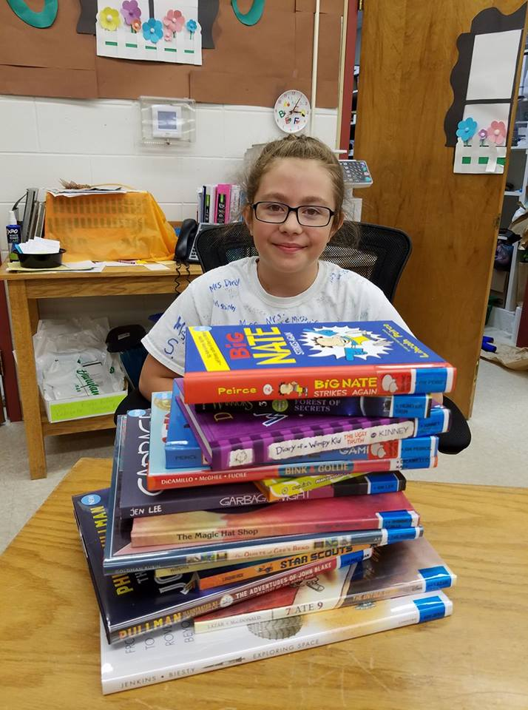
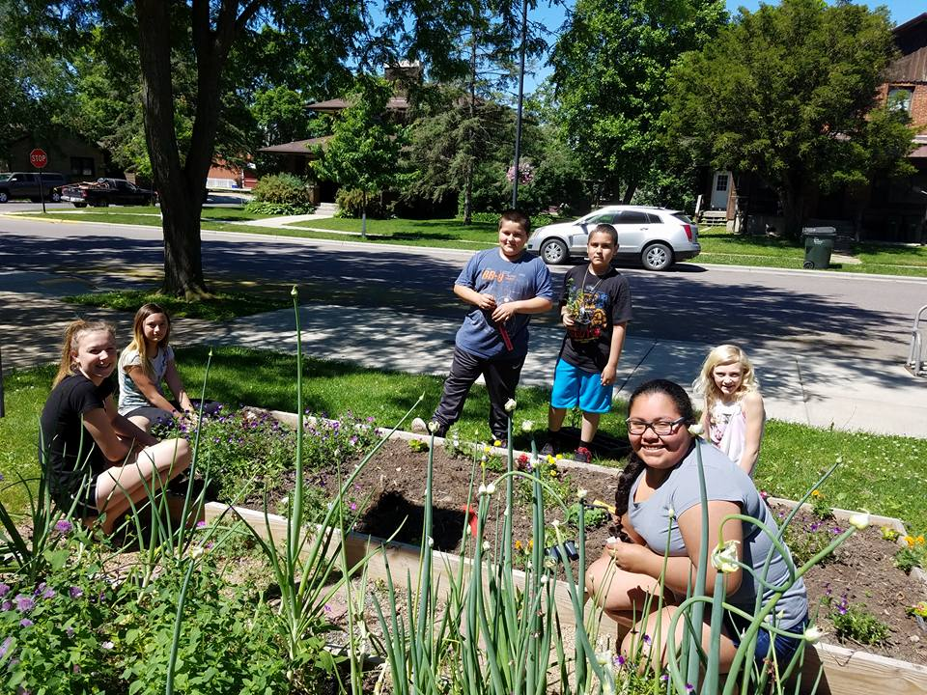
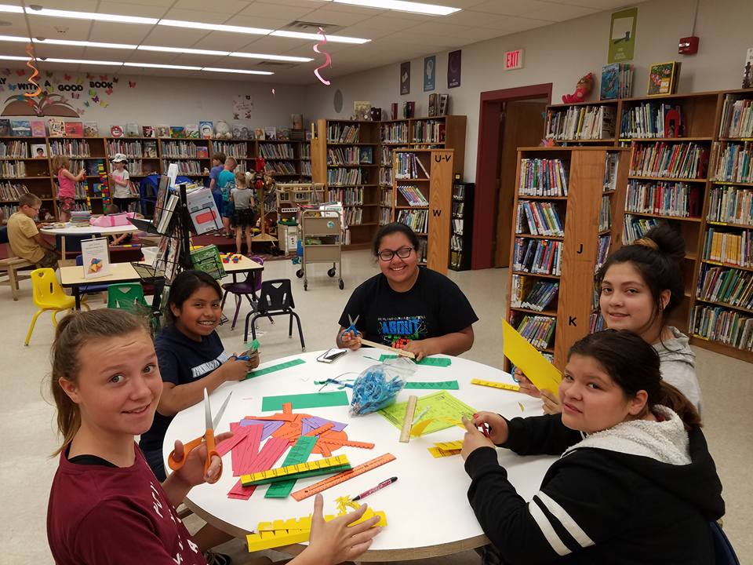
Teen Programming-
(Volunteers!)

Slide 20
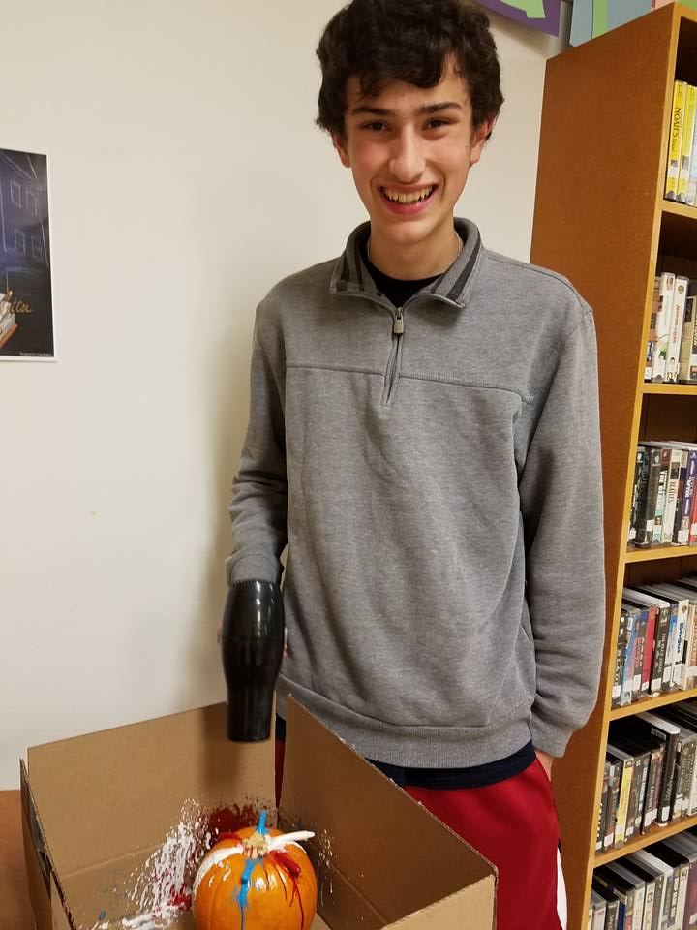
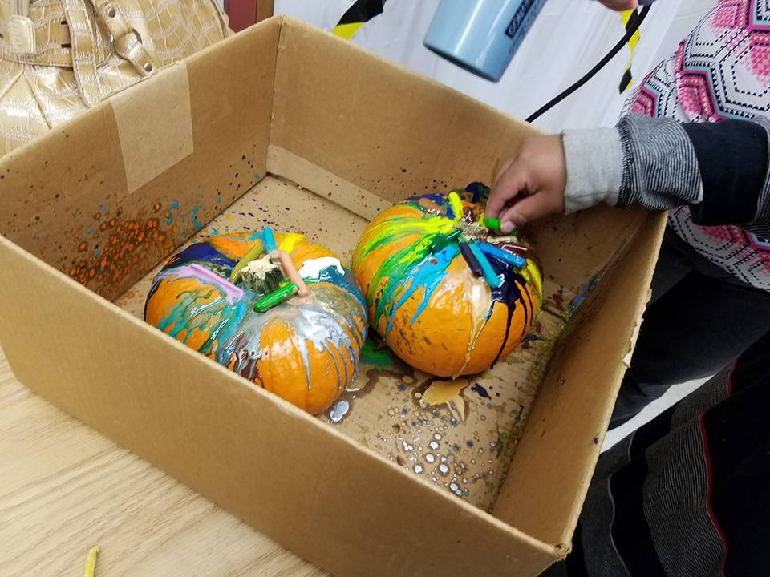
Pumpkins and Pizza!

Slide 21
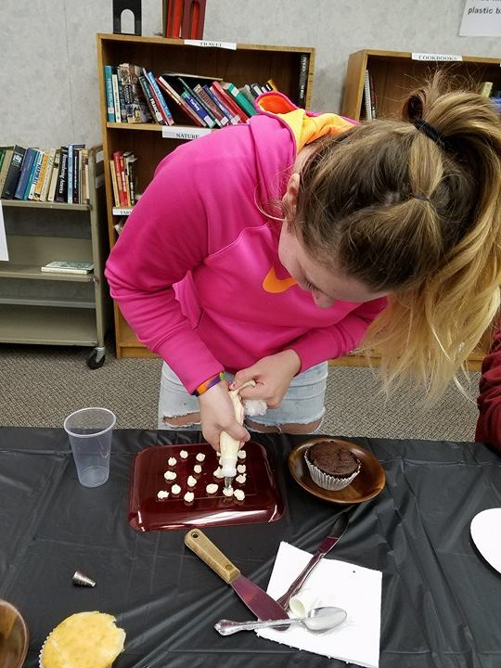
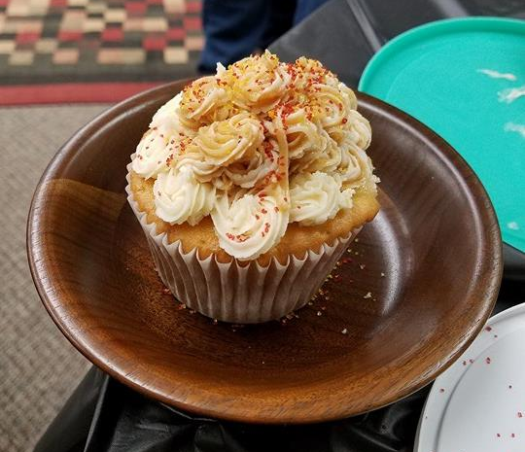
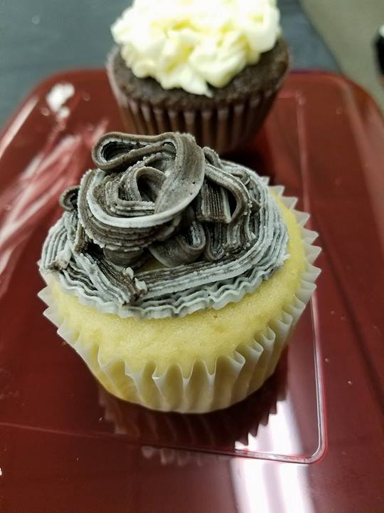
Cupcake Decorating!

Slide 22
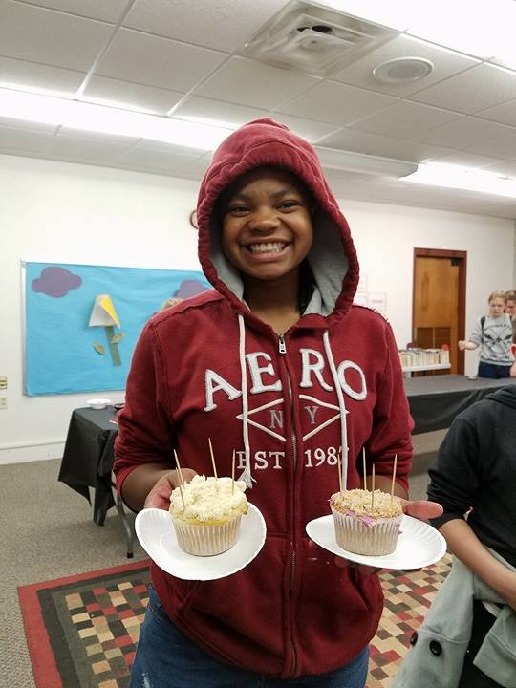
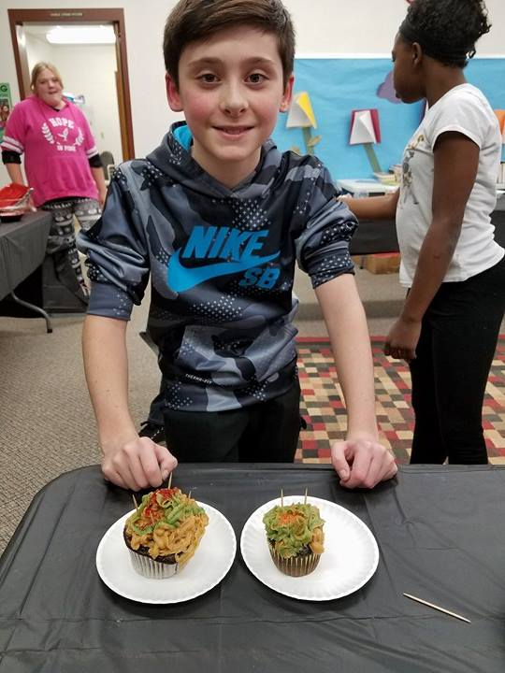

Slide 23
Grants and Funding:
Notes:
Grants:
-Friends Group
Talk with your director about what bills your library pays. Look up every one of those companies. Many of them have foundations. Since your library is a patron of their business, you are probably very likely to be accepted for any grant that you apply for, as long as it is within the scope of their foundation.
For example, I realized our library pays monthly bills to We Energies….
Talk to your local paper or radio station. Ask if you could have a news segment detailing any grants that you have won
Pay attention in your community if you hear of another program receiving grants. Ask questions.
Local funding can be your best bet because you will have built a reputation and a face.
Cultivate relationships outside of the library in your personal life. Community First Bank.
Send thank you notes immediately after being awarded. Try do send one again several months later with an update and pictures on how you used that money.
Keep an excel file of all grants, and when you spend down grant money.
Keep a record of all grants you apply for, with the name and address of the organization and any names of people you talk to. Hang this somewhere where you will see it. It makes it so much easier to write thank you notes during the year.
Grants give way to more grants.
Image source: http://www.thebluediamondgallery.com/handwriting/images/grants.jpg

Slide 24
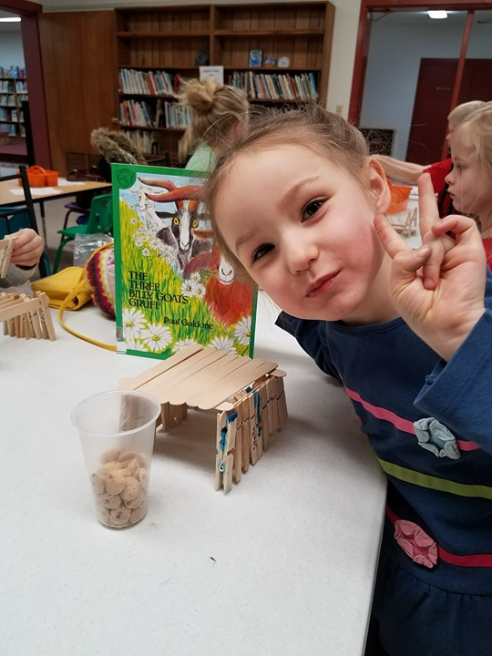
Milk and Cookies Book Club
Notes:
Idea from Lisa M. Shaia and her Thrive After Three Blog
Blog post: https://thriveafterthree.com/2016/01/19/milk-cookies-club/

Slide 25
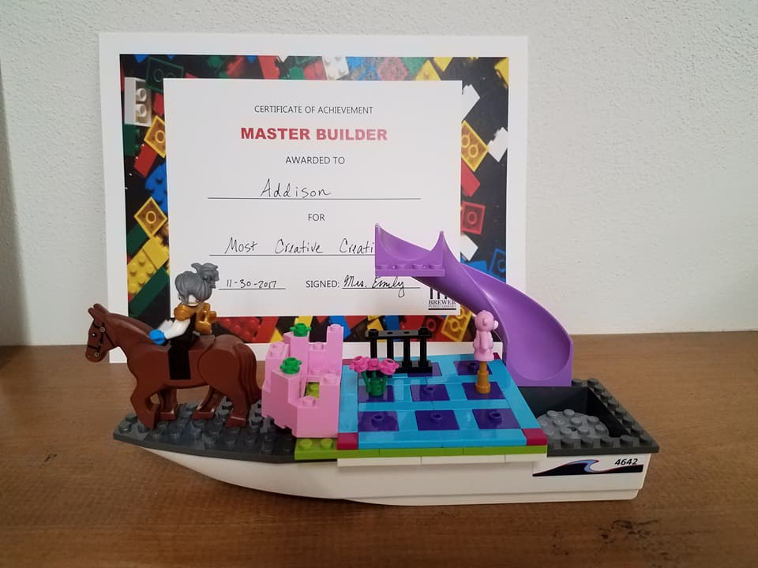
Lego Expo

Slide 26
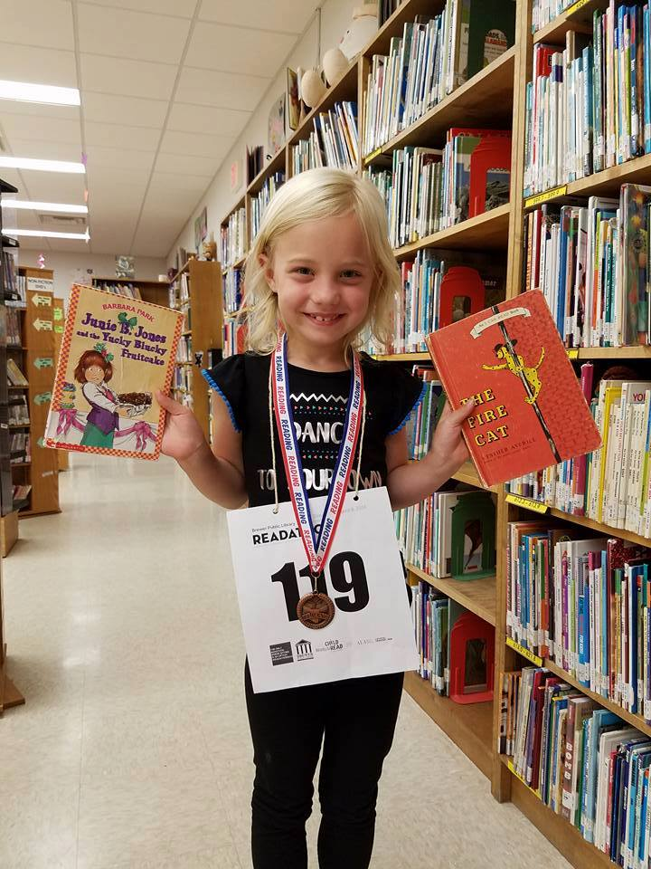
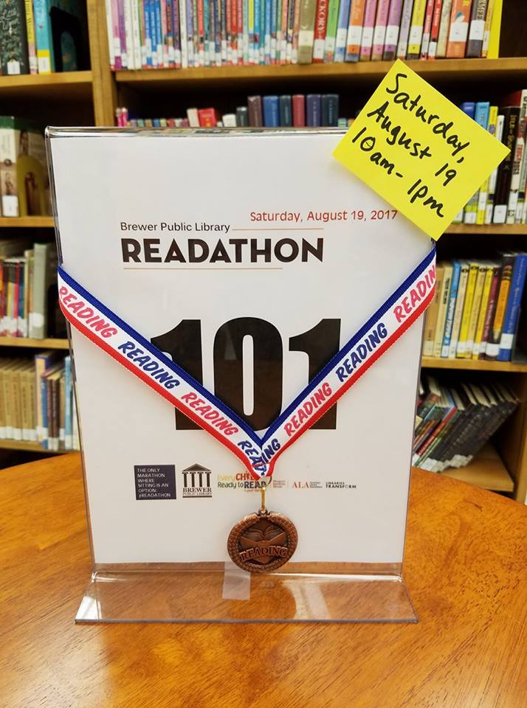
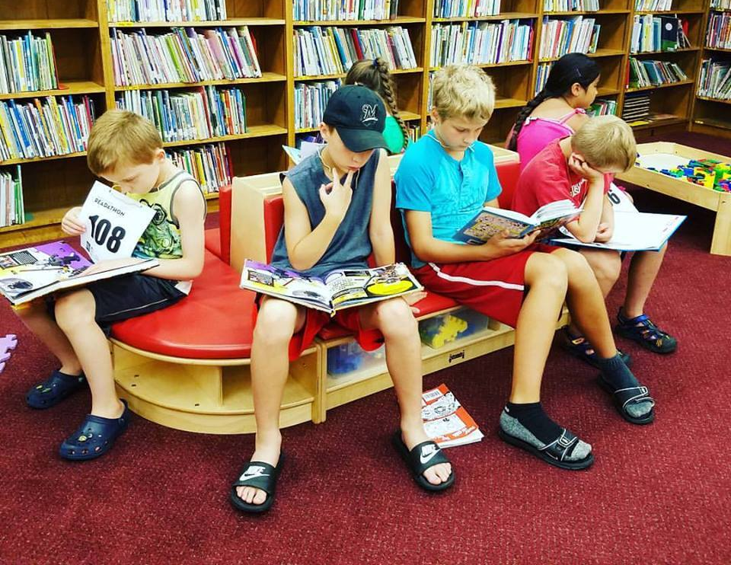
Readathon

Slide 27
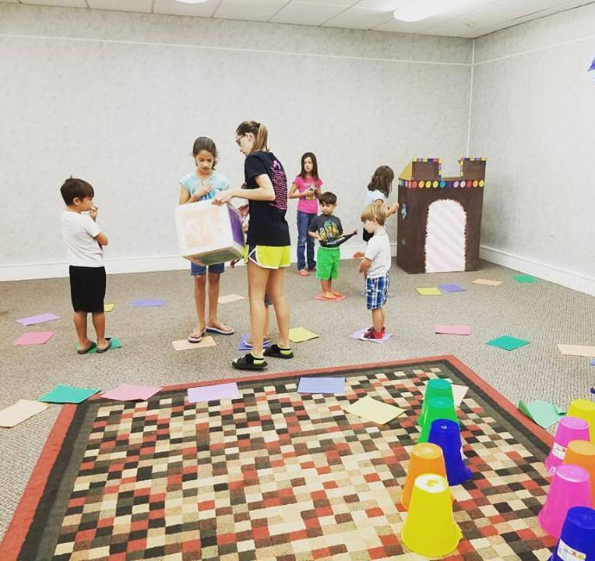
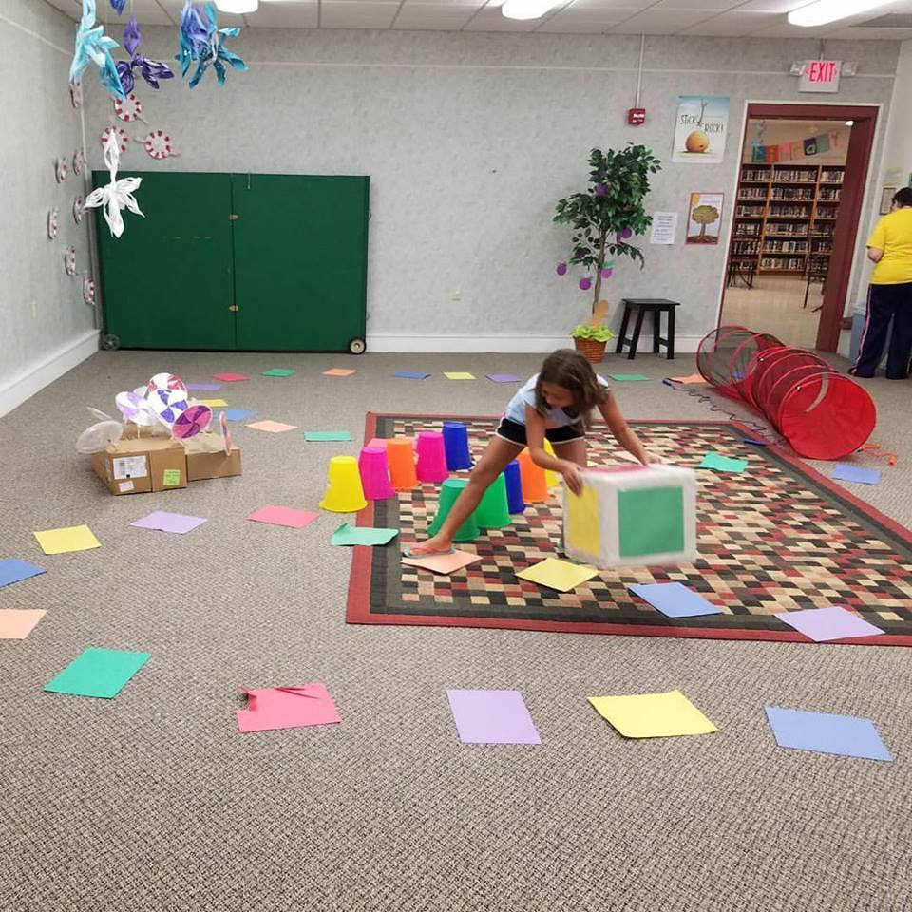
Life-Size Candyland

Slide 28
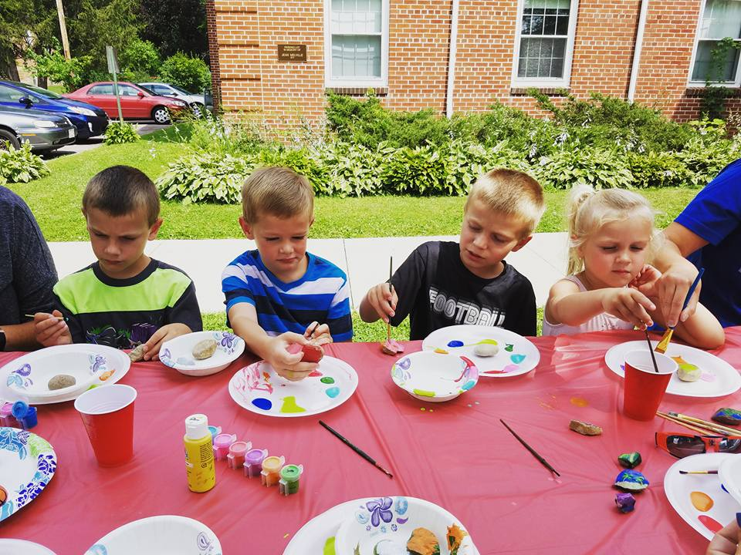
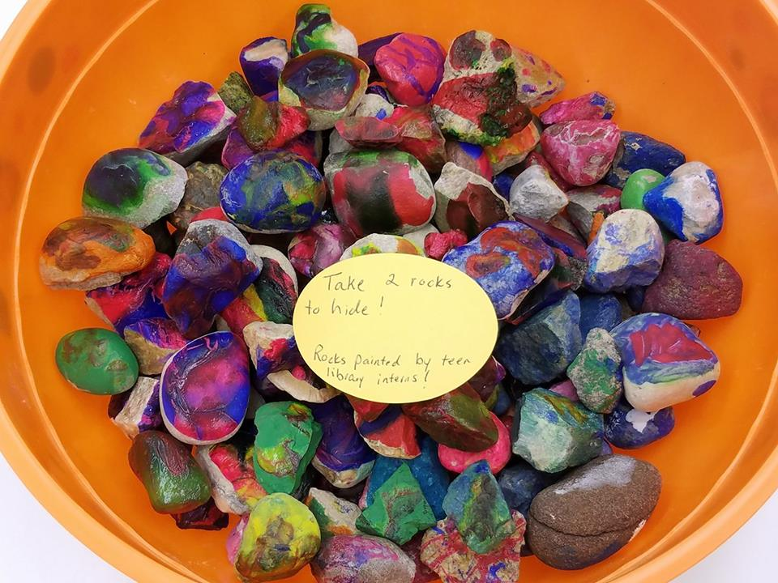
Rock Painting

Slide 29
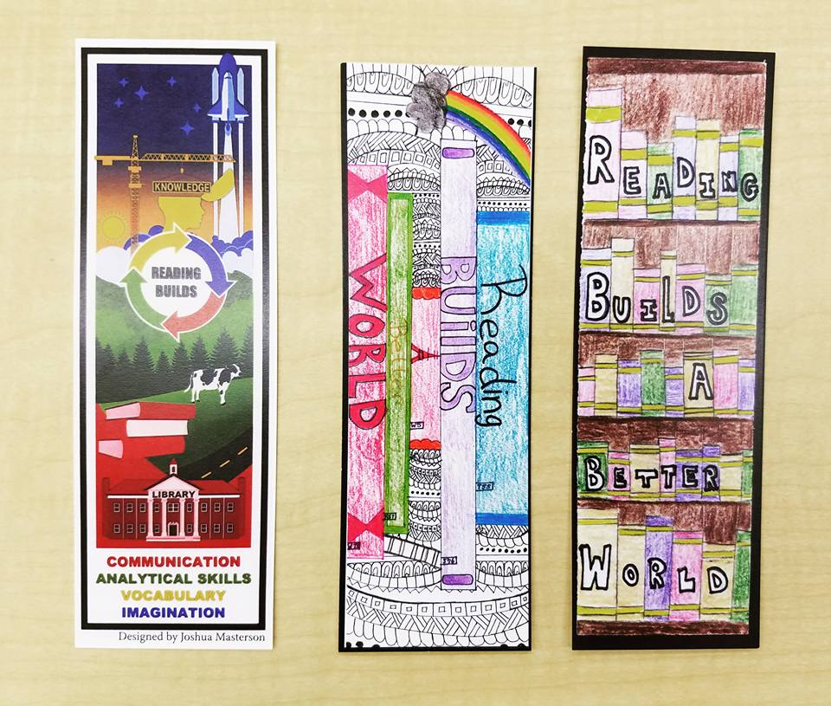
Bookmarks

Slide 30
Let’s keep good ideas circulating!
Emily Zorea
ezorea@swls.org
SowingSeedsLibrarian.com
Notes:
- Gave away books for Halloween/Trick or Treat (posted the city trick-or-treat times on Facebook with an invitation to come to the library for a free book) Shared and seen by 2,000 people.
Checkers Tournament
Homemade ice cream after city parade (homemade ice cream in a Ziploc bag) all supplies have been donated.
Toddler Tech- community organizations come and set up a booth promoting services with an activity for kids birth-5
Diary of a Wimpy Kid party
Kids workshops using different members of your community to lead the activity or be the guest speaker

