Slide 1
#PowerUP! Building Teen Leadership in Your Library & Beyond
Emily Scherrer, Library & Teen Center Manager,
City of Sierra Vista
Youth Commission Staff Liaison, City of Sierra Vista
Southern Arizona Library Representative-Arizona Library Association 2016-2018

Slide 2
#POWERUP
Notes:
Go into your background. Introduce yourself. What do you do? Library, Teen Center, Youth Commision. Talk about how Youth Empowerment came up. What we ‘re going to talk about today.
You need a group to pull from: Focus Groups, Student Councils, Youth Commission, Library Advisory Board. What is your goal, mission? Write a statement.
Creating a “Base” of Leaders
Program Background & Objectives
Funding Considerations
Program Requirements
Positive Outcomes

Slide 3
PROGRAM BACKGROUND
Youth Commission of Sierra Vista. Originally created as the Youth Council in 1972, the body was restructured as a commission in 1996. The purpose of the Youth Commission is to advise the City Council on matters of concern to the youth of Sierra Vista, recommend and encourage action programs and legislation beneficial to the youth of the community, promote better understanding and integration of youth and the local government, and assist in the planning, operation, and evaluation of the local service delivery system for youth-related services as consumers of these services.
Following recommendation, staff moved forward to create some kind of day-long leadership conference for local teens.
At least one service project per year, and one civic engagement “project.”
Notes:
Recommendations from the Council: Indoor/Outdoor, Good Food, Scholarship Opportunities. Mission—why that’s important. Stick to your goals—we can’t be everything to everyone.

Slide 4
WHY #POWERUP AND #WTF IS IT?
Notes:
We liked the name…good ring, energy behind it. A day long teen conference. We wanted to hit at risk teens too. Application, Recommendations, & Questions.

Slide 5
PROGRAM STEERING COMMITTEE
Conference must have at least one, if not two, motivational type speakers and break out sessions.
Applications reviewed and approved on a first come, first-served basis. Have requirements.
Work with area schools to promote the event and get applications. Also, approvals for days off and possible bus route options.
Must have space available to fit the number of teens allowed to attend.
Requirements for scholarship winner
Youth/Teen involvement in planning, set up, takedown, program leaders, and so forth.
Notes:
Also worked with Army, Private Schools, Homeschool Associations to promote event.

Slide 6
Registration

Slide 7
Itinerary 2016 & 2017

Slide 8
PROGRAM OBJECTIVES
Encourage and motivate area teens to think about their personal identities, the future of their city, and Arizona as a whole. Promote awareness of local government, local businesses (Local First), and non-profit opportunities in their hometown. Encourage teens to be active citizens in their communities.
Create a scholarship for at least one high school junior/senior who attended the conference based on a writing contest.
Increase visibility of teens in our community by using social media and outreach to cover event.
Include some type of remembrance project for the community to view publicly.
Make the big city “opportunities” happen in our own community.
Include “at risk” teens in the event.
Notes:
JROTC, Tombstone, Bisbee.

Slide 9
FUNDING CONSIDERATIONS
What can we use from the budget, if anything?
Donations funds for Youth/Teen projects, if available.
Youth Commission Fundraising
Staff Fundraising/Letter Writing/Community Involvement
Cost Considerations (Speakers, Food, T-shirts)
Scholarship Opportunities
Grant Funding

Slide 10
#POWERUP CONFERENCE
Notes:
Itinerary: Good, Bad, and the Ugly. Who were the Speakers—and why? Who chose the speakers?

Slide 11
#POWERUP ACTIVITIES 2016
Instagram Scavenger Hunt
Police Obstacle Course
Notes:
They wanted to be phsyical and outside. Coming up with someone for everyone is really really hard. Include a little something for everyone.

Slide 12
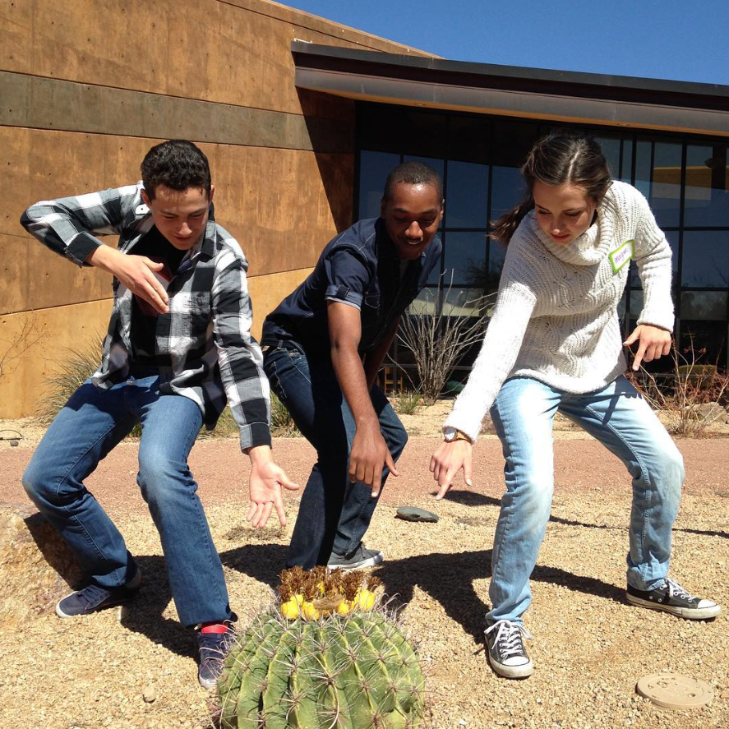
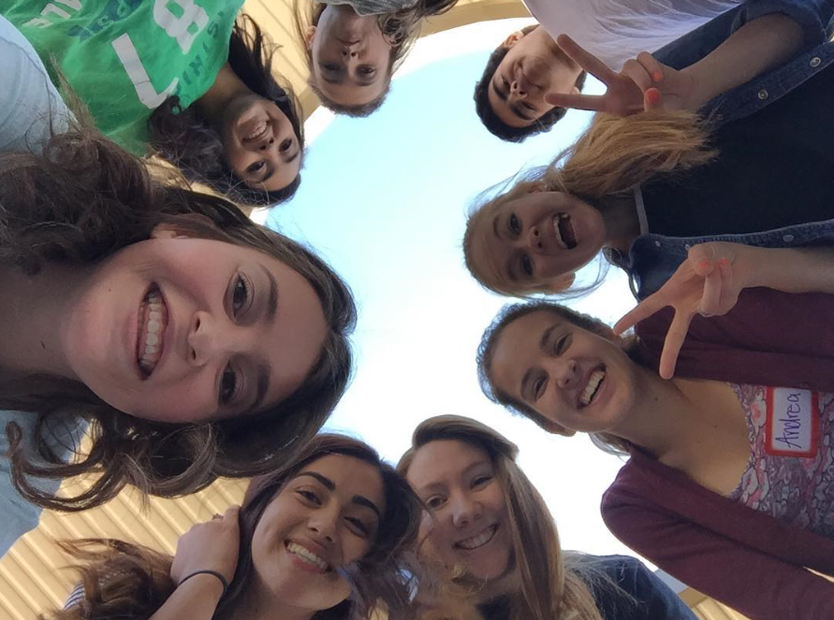
Power Up!
Instagram Scavenger Hunt

Slide 13
#POWERUP ACTIVITIES 2016
PUBLIC ART
RAP UP!

Slide 14
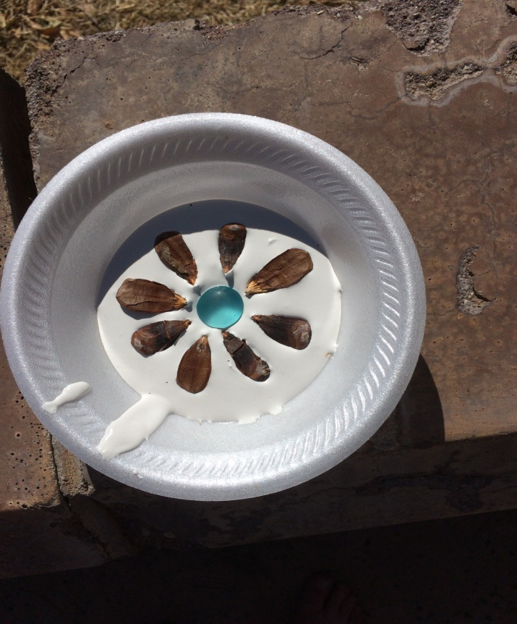
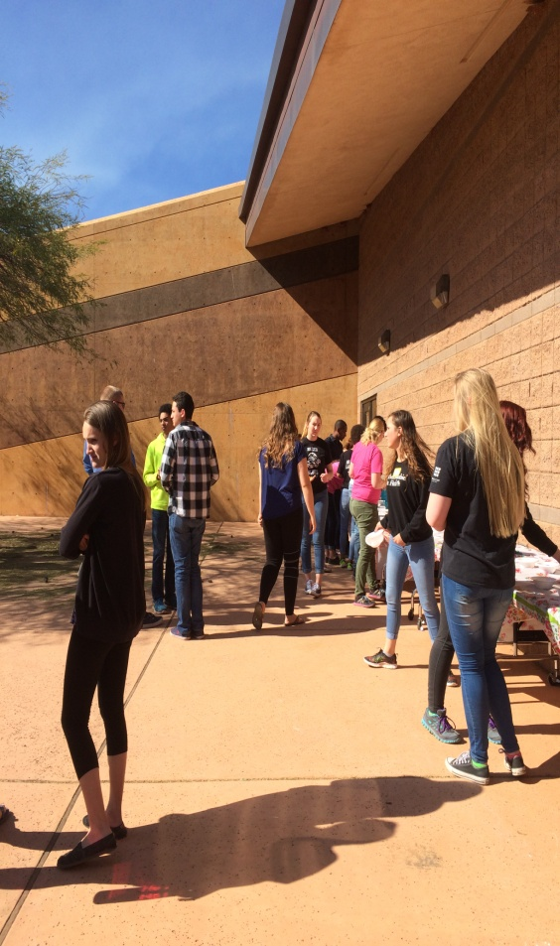
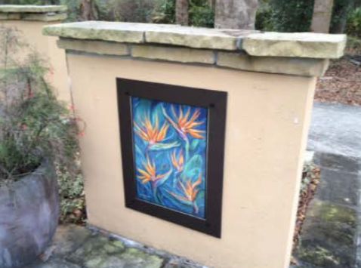
PUBLIC ART/PROJECTS
Notes:
Why This Mattered To Us (Especially the First Year)…
Other Examples: Little Free Libraries, Art Murals, LEGOS.
Hint: Make it Permanent
Why it was cut in 2017….

Slide 15
SCHOLARHIP WINNER
Literacy/Education is a tenant of Rotary Club International, so we asked them to sponsor our scholarship. It gave publicity to the club and also provided one attendee with a 1K gift to go towards college.
Winner was chosen strictly on merit, no names were allowed, and all participants wrote either an essay, short story, or poem. Art/music pieces was also considered as an option. This was controversial.
The winner, Alli Kang, chose to write about Eleanor Roosevelt and write her essay in poem form. The question we asked all teens was “Who do you admire as a leader and why?”
Notes:
Read Alli’s winning poem.

Slide 16
TAKEAWAYS
Notes:
Survey at the end to capture results, suggestions.
Transportation
Length of Day
Volunteers
“The Power of Asking”
Speakers who CARE, Speakers who EMPOWER
Food
Artistic “Styles”
Things I Wished I Knew…. (Timing, Disruptions)

Slide 17
Notes:
Table Tents at Mall, School Cafeteria.

Slide 18
OTHER POSSIBILTIES
Teen/Youth Center Involvement (Dances, Workshops)
Council Meeting Sessions
Anti-Bullying Efforts
Alternative “Spring Break”
Bridging the Divide—Digital Literacy Tutors
Teen Tech Week (Projects!)
Arlington Example, “Acting UP not OUT.”

Slide 19
WHY TEENS?

Slide 20
TEENS ARE NATURALS
Empowering youth and allowing them to participate in the community has shown to benefit their development. (Brennan, 2008).
Develops future leaders
Youth who are engaged in community efforts at a young age show better problem-solving and decision-making skills when compared to youth who are not engaged (Brennan, 2008).
Youth who develop positive relationships with adults in their communities have demonstrated better social and emotional development & show an increase in social participation and community action (Brennan, 2008).

Slide 21
THE NECESSITY ALREADY EXISTS
Neighborhood clean-up efforts, Tool borrowing kits
Hike for the Homeless
Dances, Youth Programming, “Ted Talks”, “MORTIFIED”
Tutoring, Literacy Efforts, Story Times
Alternative Spring Break
Comic-Cons, Crossfit, Coffee Shops, Collaborations
Input for Youth Centers, Libraries, Skateparks. Strategic Plan & Branding Initiatives.
Teen Town Hall

Slide 22
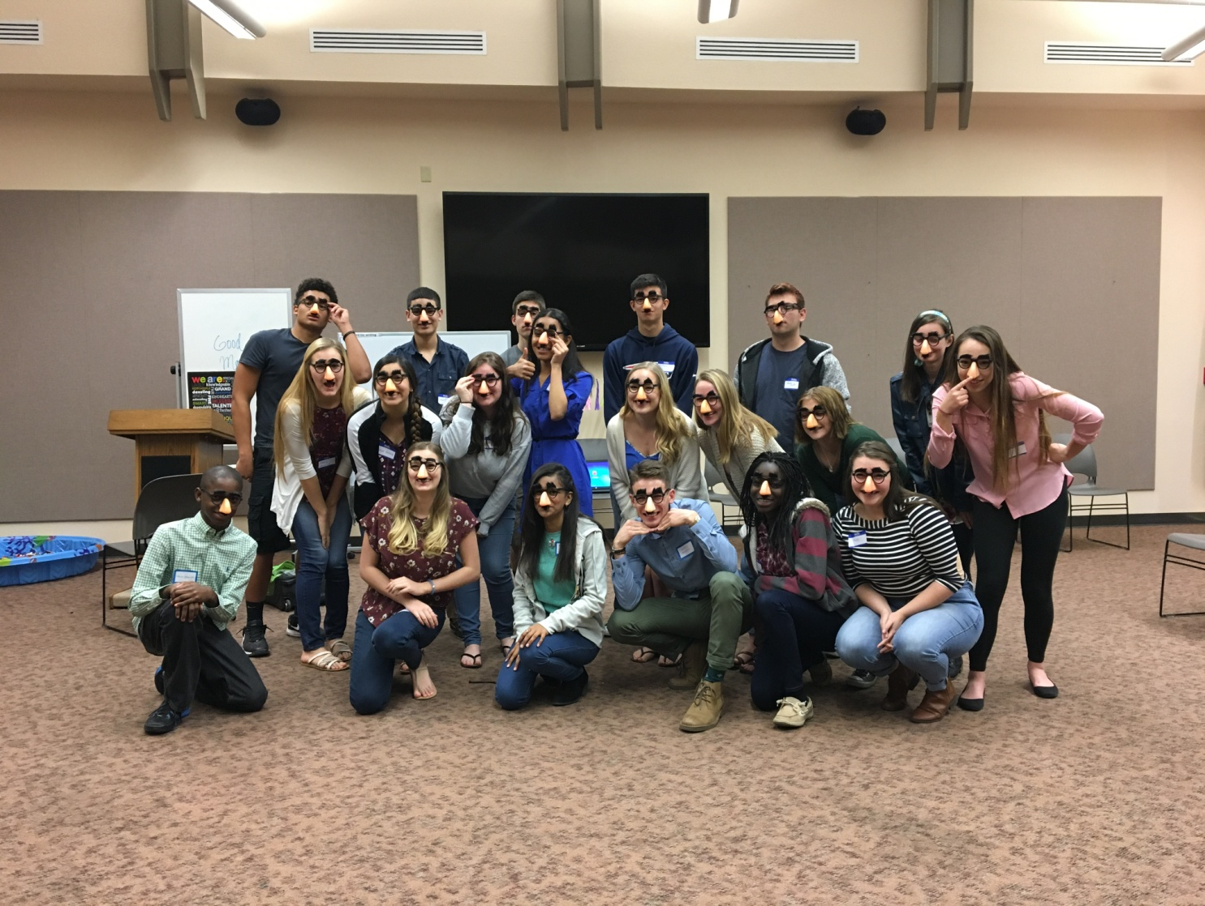
SUMMARY & QUESTIONS
Notes:
Mentorships, Shadowing Opportunities
Limitless 2017

Slide 23
CONTACT ME!
Email: Emily.Scherrer@SierraVistaAZ.gov
Ph: 520-439-2252
Facebook: Emily Scherrer
Instagram: ITSALLARIZONA
Snapchat: Emily Scherrer
Linkedin: Emily Scherrer
Notes:
Mentorships, Shadowing Opportunities
“I Want To Be A Rapper.” DJ School.
Limitless 2017
Resources

