Slide 1
Effectively managing Customer behaviors
Danielle Zeamer
Brown County Library

Slide 2
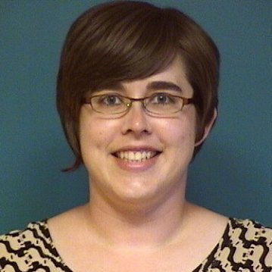
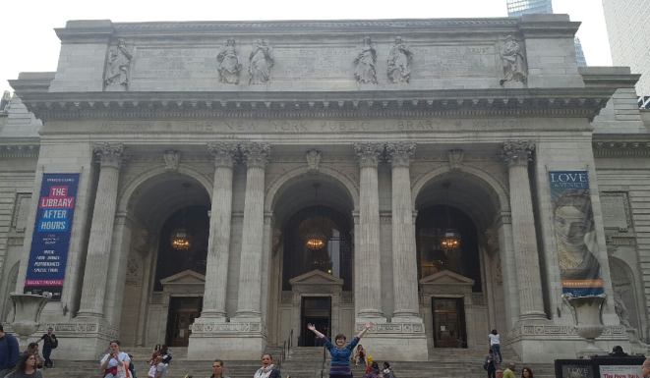
Library Service Associate
within Customer Service Department at Brown County Central Library

Slide 3
What we want to create:
Welcoming and safe environment for ALL patrons

Slide 4
What we will learn today:
What is Behavior
What Impacts Behavior
Perspective
Communication
Relationships
How to Respond to Behaviors

Slide 5
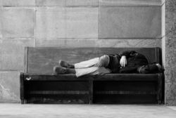
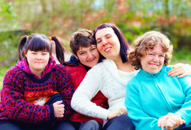
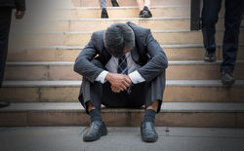
Who We Serve

Slide 6
What is Behavior?

Slide 7
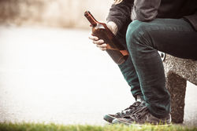
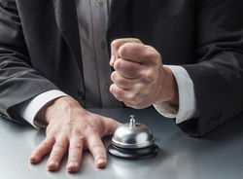
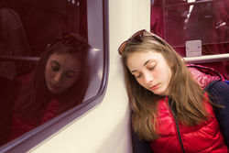
Behaviors we typically see

Slide 8
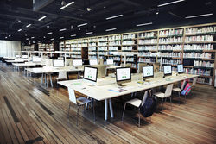
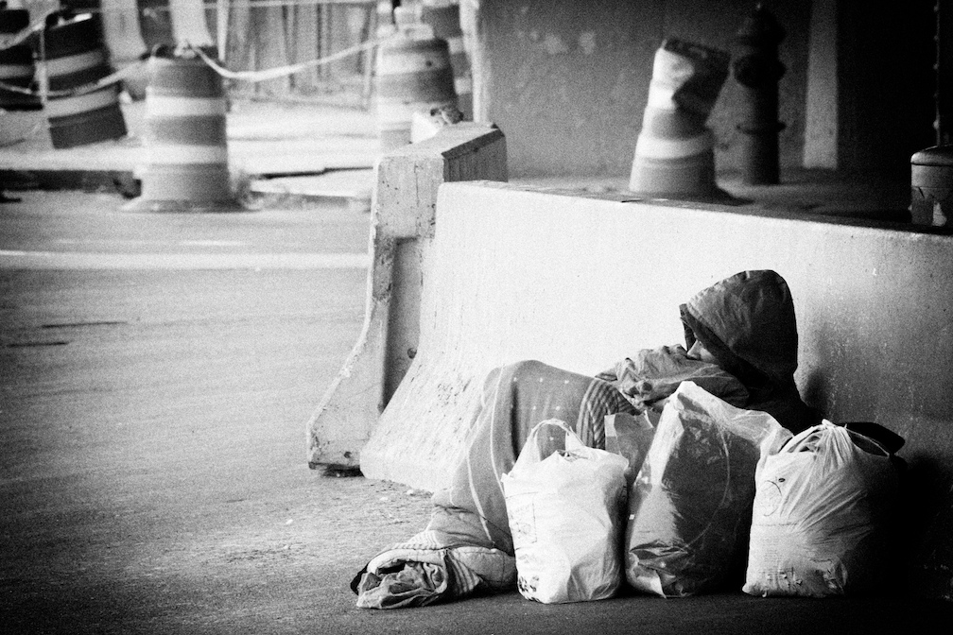
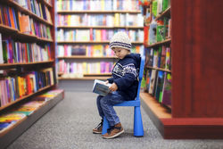
What impacts Behavior?
Need to understand why patrons use our library and their personal situations

Slide 9
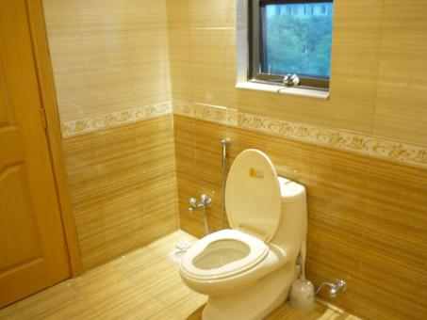
What impacts Behavior?
Need to understand why patrons use our library and their personal situations
Need to understand and ask WHY someone is displaying behavior

Slide 10
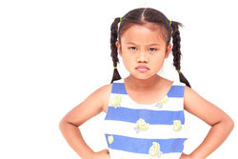
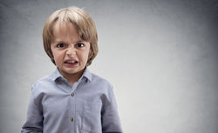
What impacts Behavior?
Need to understand why patrons use our library and their personal situations
Need to understand and ask WHY someone is displaying behavior
We cannot control behaviors; we can only control how we respond to behaviors

Slide 11
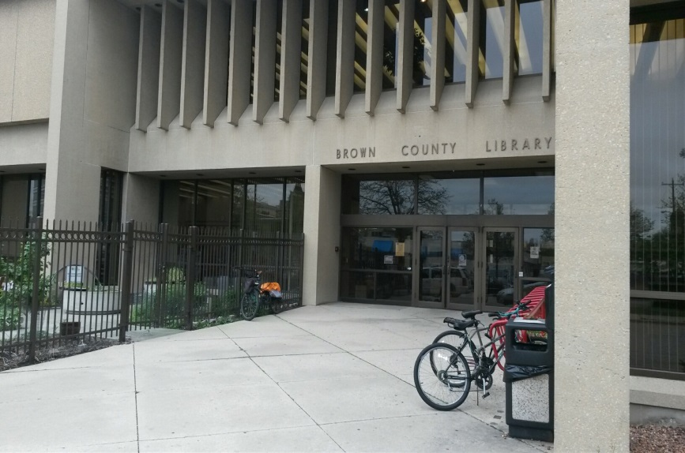
What impacts Behavior?

Slide 12
What impacts Behavior?

Slide 13
Verbal and non-verbal communication
Up to 93% of communication can be non-verbal

Slide 14
Building relationships with customers
What type of relationship are we looking for?
Create positive first impressions and utilize rapport throughout interactions
Need to balance professional vs friend

Slide 15
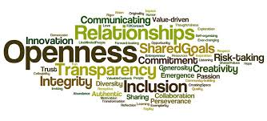
Building relationships with customers

Slide 16
Building relationships with customers

Slide 17
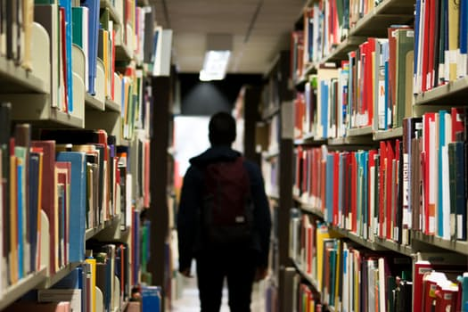
Building relationships with customers
Notes:
stock photo for dylan situation

Slide 18
Responses
Offer introductions

Slide 19
Responses
Offer direct statements that include choices to provide clear understanding of expectations
Offer introductions

Slide 20
Responses
Offer direct statements that include choices to provide clear understanding of expectations
Offer suggestions on what appropriate behavior looks like
Offer introductions

Slide 21
Responses
Offer direct statements that include choices to provide clear understanding of expectations
Offer alternatives
Offer suggestions on what appropriate behavior looks like
Offer introductions

Slide 22
Responses
Offer direct statements that include choices to provide clear understanding of expectations
Offer alternatives
Offer suggestions on what appropriate behavior looks like
Utilize community resources
Offer introductions

Slide 23
Documentation
Document patron information (or description)
Document detailed behavior
Document where the incident took place
Document (staff/library) responses
PLEASE REMEMBER: do not include opinions or speculations

Slide 24
Response Plan
If you have a regular patron who needs a little more assistance than typical or who typically presents behaviors, a response plan may be useful
Behavior
Behavior
Behavior
Response Plan
Behavior

Slide 25
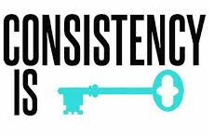
Response Plan
Could Outline:
Behavior typically seen
Desired staff response
Staff who should be aware of plan
This will increase consistency with/between staff

Slide 26
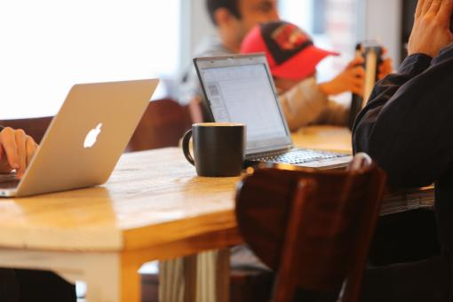
Response Plan

Slide 27
Response Plan
Seek input from community resources and/or law enforcement to develop

Slide 28
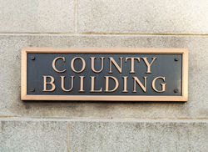
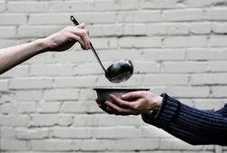
Response Plan

Slide 29
Danielle Zeamer
zeamer_ds@co.brown.wi.us
Brown County Library
Customer Service Department

